Slide 1


Cincinnati Retirement System Retirement 101: Group G
Hired 1/1/2010 – 12/31/2015
2026
1

Slide 2



CINCINNATI RETIREMENT SYSTEM
Welcome to CRS!
Our Mission: Help members retire successfully
Established in 1931; pre-dates Social Security
Public employees in OH do not participate in Social Security
CRS members can be eligible for Social Security through a previous employer
CRS covers only certain City of Cincinnati employees
Excludes: Sworn Police and Fire (OP&F), Elected Officials and other City employees in OPERS.
2

Slide 3

CRS Operations
What We Do:
Enroll New Members
Process 457 Plan Enrollments
Process Service Purchases
Process Return of Contributions
Process Retirement Applications
Process Retiree Healthcare Open Enrollment and Medicare Transitions
Process Death Benefits
Member Education and Customer Service
3

Slide 4

CRS Funding
CRS Pension Benefits are Funded by Contributions + Investment Earnings
City contributes at least 16.25% of payroll
Employees contribute 9%
CRS Board of Trustees invest the contributions and earn an investment return
Current CRS Assets = $2.2 billion
Annual CRS benefit payments = $219.4 million
Funded ratio (pension) = 71.6%
Funded ratio (health) = 145.1%
4

Slide 5

CINCINNATI RETIREMENT SYSTEM
CRS Benefits: Why?
Long-term Public Service
Retirement Security
5

Slide 6


Monthly Pension Benefit
CRS provides a “Defined Benefit” pension
“Defined Benefit” means your pension is calculated by a formula that is “defined” by law – guaranteed monthly payment for the rest of your life
Retirement
Decade 1, 120 payments
Day both You and your Optionee have passed
Decade 2, 120 payments
Decade …., x payments
Different than a “Defined Contribution” plan which provides no guaranteed return or regular monthly retirement income stream.
Retirement
Decade 1
Day both You and your Optionee have passed
Decade 2
Decade ….
6

Slide 7



Pension Calculation Formula:
Service Credit earned for every base hour paid in a calendar year (1 year of service = 2080 hours maximum)
Service Multiplier
Avg. High. Comp.
Years of Service
7

Slide 8

Service Credit earned for every base hour paid in a calendar year
(1 year of service = 2080 hours maximum)
Service Multiplier
Group G: before 30 years 2.2%; after 30 years 2.0%
Average Highest Compensation (AHC)
Group G: Highest 60 consecutive months of pensionable earnings occurring anytime during membership
8

Slide 9

Retirement Eligibility for Group G:
Normal = age 67 with a minimum of 5 years service
Employees become vested members of CRS with 5 years of service.
Normal = age 62 with a minimum of 30 years service
Early = minimum age 57 with a minimum of 15 years service (actuarially reduced).
Early Retirement from service ONLY
9

Slide 10

Retirement Eligibility for Group G:
Deferred =
If you terminate employment PRIOR TO reaching
retirement eligibility and leave your contributions
with CRS, you can receive a pension at age 67 if
less than 30 years or at age 62 with 30 or more
years.
10

Slide 11
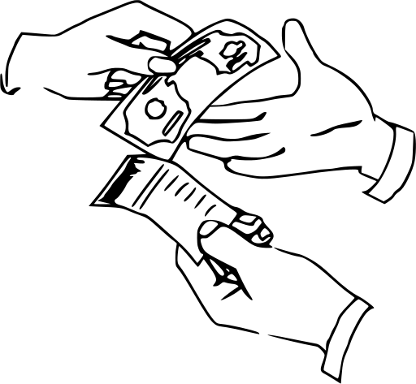
Purchasing Service Credit
Members can add to the service credit they earn as a City employee by purchasing service credit
Prior, refunded City of Cincinnati service credit
Note: CRS original membership dates cannot be changed through purchases or transfers
Prior Military service credit
Members can purchase up to three years of honorably discharged active-duty military service
11

Slide 12
Purchasing Service Credit (cont.)
Prior contributing service with another public employer with a defined benefit plan that you have refunded from (Out of State & Federal)
Other Ohio Retirement System service (OPERS, STRS, SERS, OP&F) that is non-concurrent
You can use 457 funds to purchase
service credit.
12

Slide 13
Deferred Compensation (457 Plan)
Allows members to save additional amounts pre-tax (Traditional) and post-tax (ROTH) for retirement
Used to supplement Monthly Pension Benefit
Get a CRS Benefit Estimate
Ask yourself if your Monthly Pension Benefit will be enough
Consider increasing contribution to 457 Plan
City provides a match to most employees
AFSCME: $500; CODE & Non-Rep: $750 (Match is only paid on Pre-Tax Deferrals)
457 Plans: Ohio457, MissionSquare
13

Slide 14

Monthly Pension Benefit
Example (Group G):
28 years service (7/1/2012 – 6/30/2040)
Avg Annual Highest Compensation= $82,000
2.2% x 28 x 82,000 = $50,512 annual
If final salary is $86k, base benefit provides 59% salary replacement
3% simple interest COLA added on retirement anniversary date at the start of the 4th year of retirement and then annually after that
14

Slide 15

Leaving City Employment
Options if you leave City employment prior to becoming eligible for retirement benefits:
Leave your contributions in CRS & Defer
Ideal option for members who have earned the 5 years of service required for benefit eligibility (vested) but haven’t reached the required age
Refund your contributions
Ideal option for members who have not vested (have less than 5 years service) and do not intend to return to the City – cash refund or rollover to other retirement plan.
15

Slide 16

Death in Service Benefit
Employee with 20 years service: spouse eligible for Option 1 monthly pension benefit on the date employee would have been eligible had they lived
Legally married Spouse must be designated as sole primary beneficiary
Please keep your beneficiaries current!
16

Slide 17
Monthly Pension Benefit
Who Can Be My Optionee?
Anyone…but if you are married, it must be your legally married spouse (unless spouse waives the benefit)
You select your Optionee and Option at retirement:
Option 1 (100%):
Same reduced benefit for life of retiree and optionee
Option 2 (50%):
Benefit reduced to 50% if retiree dies first
17

Slide 18
Monthly Pension Benefit (cont)
Option 3 (66 2/3%):
Benefit reduced to 66 2/3% upon death of retiree or optionee
Option 4 (80%):
Benefit reduced to 80% upon death of retiree or optionee
All option amounts are actuarially reduced from the base benefit based on your age and optionee’s age on retirement date.
18

Slide 19

Monthly Pension Benefit
What happens when I die?
No Optionee selection:
Monthly Pension Benefit ends
Optionee selection:
Monthly Pension Benefit continues until Optionee dies, unless Optionee has already passed
19

Slide 20
Retiree Healthcare
Retirement Eligibility is different from Healthcare Eligibility
Different criteria
Being eligible to retire does NOT guarantee eligibility for retiree healthcare.
CRS retiree healthcare coverage is different from Active City employee coverage:
Dependent eligibility
Medicare Part B required
Deductibles start over in retiree healthcare
20

Slide 21
Retiree Healthcare
Everyone must purchase Medicare B once you reach Medicare eligibility age (65 years old & retired & not covered by an active employer plan)
All Group G members are eligible for Free Medicare A through the Social Security Administration
21

Slide 22

Retiree Healthcare
Model Healthcare Plan Eligibility
Normal Retirement: Minimum age 62, with 30 years of service (minimum 20 years membership service)
Normal Retirement: Minimum age 67, with 20 years of service (minimum 20 years membership service)
22

Slide 23
Model Healthcare Plan Eligibility
Early Retirement: At or above age 60 and below age 62 with 30 years of service (minimum 20 years membership service)
Early Retirement: At or above age 60
and below age 67 with 20 years of service (minimum 20 years membership service)
Deferred Retirement – If eligible, Healthcare eligibility age is pushed to Medicare age or normal retirement age, whichever is later
23

Slide 24

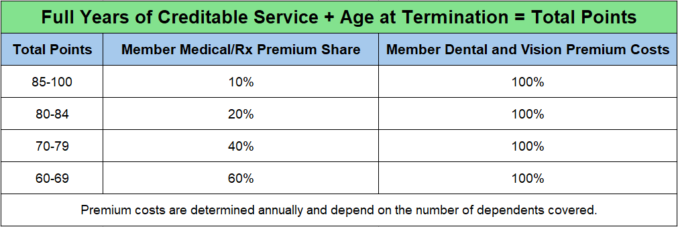
Premium Share Based on Point Grid
Monthly CRS retiree healthcare Premiums drop substantially once member is
enrolled in Medicare
24

Slide 25
Pre-65 Model Healthcare Plan
Very similar to CoC Active Healthcare Plan
65 + Model Medicare Advantage Plan
Members enroll in Medicare Part A (Hospital Insurance) and Medicare Part B (Medical Insurance)
Members pay monthly Medicare Part B premium to Social Security
Medicare Advantage covers medical and prescription costs
25

Slide 26


Retiree Healthcare
Dental and Vision coverage available separately
26

Slide 27

Retirement Process
At least 5 yrs before planned retirement date
Get a CRS benefit estimate
Make an estimated retirement budget
Ask questions about your eligibility for CRS benefits
27

Slide 28

Retirement Process
Retirement application process
Notify your department’s HR Liaison
Complete an application at least 9 weeks before your planned retirement date
Attend a CRS Retirement Processing Session
28

Slide 29
Social Security
You may be eligible for Social Security from working for a different employer; City of Cincinnati is not a Social Security employer
If you are eligible for Social Security benefits, they may be reduced under the Windfall Elimination Provision
Social Security survivor benefits from an eligible spouse may be eliminated also under the Government Pension Offset provision
Check out www.SSA.gov and set up an account to see where you stand
REPEALED
29

Slide 30

Resources
CRS: www.cincinnati-oh.gov/retirement/
Ohio457: www.ohio457.org/resources
MissionSquare: www.missionsq.org
Social Security: www.ssa.gov
Medicare: www.medicare.gov
MemberDirect: www.crsmemberdirect.org
MemberDirect is a CRS portal that allows you to see your retirement account information.
Set up an account with a personal email address today!
30

Slide 31

Questions or Feedback?
Please visit the CRS Website:
https://cincinnati-oh.gov/retirement/
Email: retirement@cincinnati-oh.gov
Counselor: retirementcounselor@cincinnati-oh.gov
Office:
City Hall, Room 328
801 Plum Street
Cincinnati, OH 45202
(513) 352-3227
Please keep CRS updated on your contact info!
31

