Slide 1


Cincinnati Retirement System
Retirement 101: Group F
2026
1

Slide 2


CINCINNATI RETIREMENT SYSTEM
→Welcome to CRS!
Our Mission: Help members retire successfully
Established in 1931; pre-dates Social Security
  Public employees in Ohio do not participate in Social Security
  CRS members can be eligible for Social Security through a previous employer
CRS covers only certain City of Cincinnati employees. Excludes:
  Sworn Police and Fire (OP&F), Members of Ohio systems (OPERS), Elected Officials
2

Slide 3
CINCINNATI RETIREMENT SYSTEM
→CRS Benefits
Different types of retirement benefits:
  Monthly Pension Benefit
  Retiree Healthcare
  Deferred Retirement Option Plan
  Disability Retirement Benefits
  Survivor Benefits
  Deferred Compensation (457 Plan)
Eligibility for each type of benefit differs
  It can be complicated - call us with questions!
3

Slide 4
CINCINNATI RETIREMENT SYSTEM
→CRS Operations
What We Do:
  Enroll New Members
  Administer 457 Plan Enrollments & Changes
  Process Service Purchases
  Process Return of Contributions
  Administer DROP program
  Pension Payroll Administration
  Retiree Healthcare Administration and Medicare Transitions
  Process Death and Survivor Benefits
  Retirement Counseling and Customer Service
4

Slide 5
CINCINNATI RETIREMENT SYSTEM
→CRS Funding
CRS Benefits are Funded by Contributions + Investment Earnings
  City contributes at least 16.25% of payroll
  You contribute 9%
CRS Board of Trustees invest the contributions and earn an investment return
Current CRS Assets = $2.5 billion
Annual CRS benefit payments = $219.4 million
Funded ratio (pension) = 68.2%
Funded ratio (health) = 145.1%
5

Slide 6
CRS Board of Trustees
CRS Board of Trustees are responsible for approving the overall budget of the Retirement System, as well as the investment plan and asset allocation strategy of the CRS Trust.
CRS Board of Trustees consists of nine (9) members:
  2 Active Employees
  3 Retirees
  4 Mayoral Appointees
Active and Retiree Trustees are elected by their respective peers.
  Serve four-year terms; meetings occur once a month.
  Active & Retiree trustee elections are staggered, so that only one seat is up for election at a time.
  Next Active Trustee Election: Spring of 2026
CRS Board of Trustees have a fiduciary responsibility to always act in the best interest of the System and its membership.
https://www.cincinnati-oh.gov/retirement/crs-board-of-trustees/

Slide 7
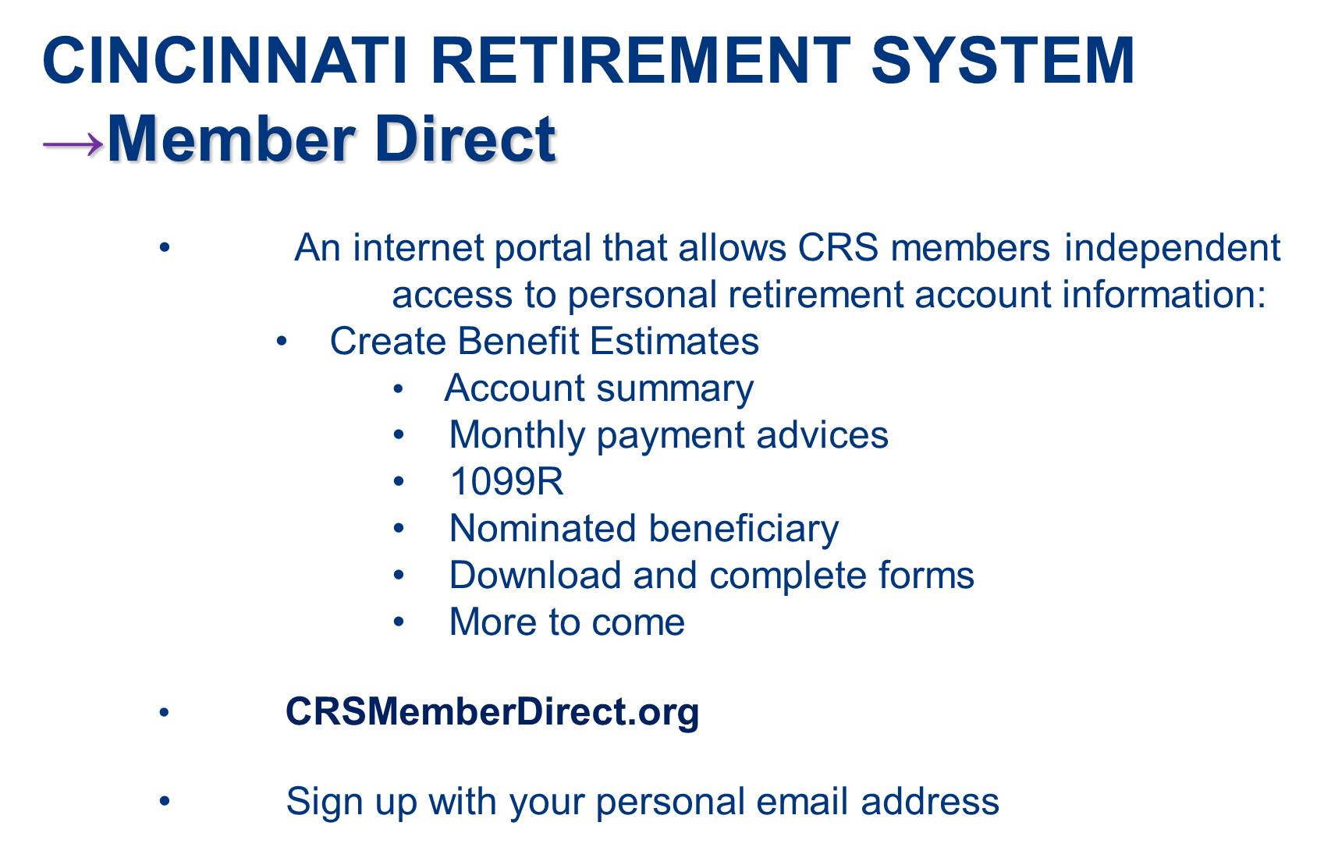

Slide 8
CINCINNATI RETIREMENT SYSTEM
What do I get for my City service?
Long-term Public Service
Retirement Security
8

Slide 9


CINCINNATI RETIREMENT SYSTEM
→Monthly Pension Benefit
CRS provides a “Defined Benefit” pension
  “Defined Benefit” means your pension is calculated by a formula that is “defined” by law – guaranteed monthly payment for the rest of your life
  Different than “Defined Contribution” plan which provides a lump sum at retirement and no guarantees
Retirement
Decade 1, 120 payments
Day both You and your Optionee have passed
Decade 2, 120 payments
Decade …., x payments
Retirement
Decade 1
Day both You and your Optionee have passed
Decade 2
Decade ….
9

Slide 10
CINCINNATI RETIREMENT SYSTEM
→Monthly Pension Benefit
Retirement Eligibility for Group F:
    Normal at Age 60 & minimum 5 yrs. Service
    Normal at any age with a minimum of 30 yrs. Service
    Early at age 55 with minimum 25 years service (actuarially reduced from Age 60 & Not eligible for retiree healthcare)
    Deferred – if you terminate employment PRIOR TO reaching retirement eligibility and leave your contributions with CRS, you can receive a pension at age 60 (Retiree Healthcare eligibility may be affected or delayed)
10

Slide 11
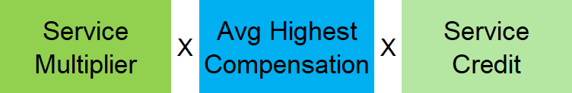
CINCINNATI RETIREMENT SYSTEM
→Monthly Pension Benefit
Pension Calculation Formula:
Service Credit earned for every base hour paid
(1 year of service = 2080 hours maximum)
  Up to 20 years service or service on 7/1/11 = 2.5%
  Afterwards = 2.2%
Average Highest Compensation (AHC)
  Group F: Highest 36 consecutive months of pensionable earnings & highest 60 consecutive months of pensionable earnings.
11

Slide 12
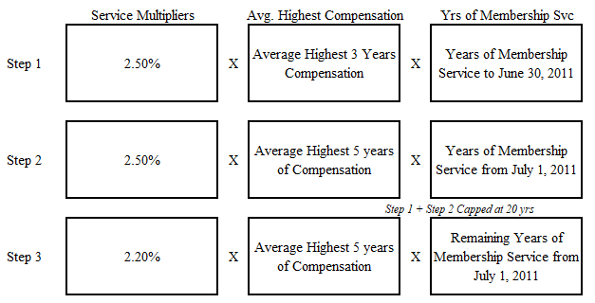
CINCINNATI RETIREMENT SYSTEM
→Monthly Pension Benefit: Group F
12

Slide 13
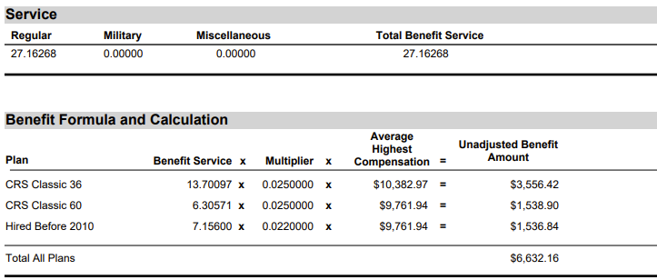
CINCINNATI RETIREMENT SYSTEM
→Monthly Pension Benefit: Group F
13

Slide 14
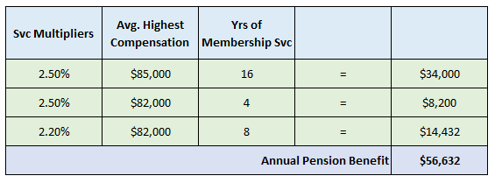
CINCINNATI RETIREMENT SYSTEM
→Monthly Pension Benefit
Example (Group F):
  28 yrs svc. (7/1/1995 – 6/30/2023)
  AHC 3 = $85,000; AHC 5 = $82,000
  If final salary is $86k, base benefit provides 66% salary replacement
  3% simple interest COLA added at start of 4th year of retirement
14

Slide 15

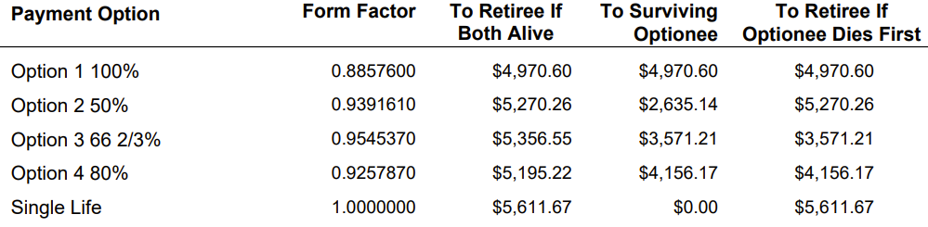

CINCINNATI RETIREMENT SYSTEM
→Estimate Example

Slide 16
CINCINNATI RETIREMENT SYSTEM
→Monthly Pension Benefit
Who Can Be My Optionee? Your legally married spouse (unless waived)
You select your Optionee and Option at retirement:
  Option 1 (100%): Same reduced benefit for life of retiree and optionee
  Option 2 (50%): Benefit reduced to 50% if retiree dies first
  Option 3 (66 2/3%): Benefit reduced to 66 2/3% upon death of retiree or optionee
  Option 4 (80%): Benefit reduced to 80% upon death of retiree or optionee
All options are actuarially reduced from the base benefit
16

Slide 17
CINCINNATI RETIREMENT SYSTEM
→Monthly Pension Benefit
What happens when I die?
  No Optionee selection: Monthly Pension Benefit ends
  Optionee selection: Monthly Pension Benefit continues until Optionee dies, unless Optionee has already passed
17

Slide 18
CINCINNATI RETIREMENT SYSTEM
→Monthly Pension Benefit
Purchasing Service Credit
  Members can add to the service credit they earn as a City employee by purchasing service credit
    Prior Military service credit
      Members can purchase up to three years of honorably discharged active-duty military service
    Prior contributing service with another public employer with a defined benefit plan that you have refunded from (Out of State & Federal)
    Other Ohio Retirement System service (OPERS, STRS, SERS, OP&F) that is non-concurrent.
18

Slide 19
CINCINNATI RETIREMENT SYSTEM
→Retiree Healthcare
  Retirement Eligibility is different from Healthcare Eligibility
  Different criteria
  Being eligible to retire does NOT guarantee eligibility for retiree healthcare
  CRS retiree healthcare coverage is different from Active City employee coverage
  Dependent eligibility
  Medicare Part B required
  Deductibles start over in retiree healthcare
19

Slide 20
CINCINNATI RETIREMENT SYSTEM
→Retiree Healthcare
Model Healthcare Plan
  Only available to retired members w/ membership date before 1/1/2010
  At age 60, with 20 years of service
  At any age, with 30 years of service
    For members who hired after 1/9/97 and who leave City employment and defer, eligibility age is pushed to Medicare age or normal retirement age, whichever is later
  Cost structure:
20

Slide 21
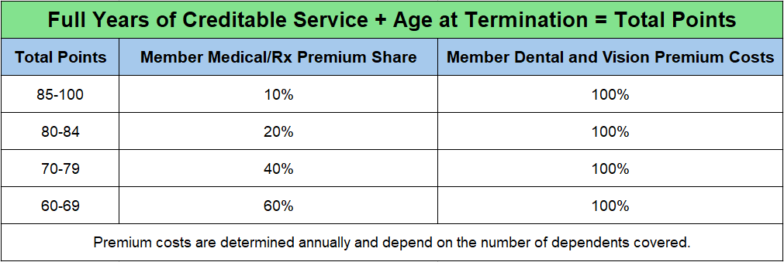
CINCINNATI RETIREMENT SYSTEM
→Retiree Healthcare
Monthly Premium Share
  Membership Date before 1/9/97: 10%
  Membership Date on or after 1/9/97: Point Grid
Premiums drop substantially once member is eligible for Medicare (65)
21

Slide 22
CINCINNATI RETIREMENT SYSTEM
→Retiree Healthcare
Pre-65 Model Healthcare Plan
  Very similar to CoC Active Healthcare Plan
65 + Model Medicare Advantage Plan
  Members enroll in Medicare Part A (Hospital Insurance) and Medicare Part B (Medical Insurance)
  Members pay monthly Medicare Part B premium to Social Security
  Medicare Advantage covers medical and prescription costs
Dental and Vision coverage available separately
22

Slide 23
CINCINNATI RETIREMENT SYSTEM
→Deferred Retirement Option Plan
DROP
  Defer retirement for up to 5 years
  Continue to work as City employee
  Monthly pension benefit accrues in account
  75% of employee’s CRS contribution saved
  DROP account earns interest
  DROP account paid out as lump sum at retirement
  Eligibility:
    30 years service & CSA Current Employee Class Member
      Active employee on 7/1/2011
      5 years svc on 7/1/2011
23

Slide 24
CINCINNATI RETIREMENT SYSTEM
→Survivor Benefits from CRS
An active employee with at least 18 months of service that becomes deceased:
  The surviving spouse and minor children are eligible for a one-time, lump sum payout of two-thirds (2/3) of the employee’s annual salary.
24

Slide 25
CINCINNATI RETIREMENT SYSTEM
→Death in Service Benefits
Employee with 20 yrs svc: spouse eligible for Option 1 monthly pension benefit on date employee would have been eligible
    Legally married Spouse must be designated as sole primary beneficiary
Please keep your beneficiaries current!
25

Slide 26
CINCINNATI RETIREMENT SYSTEM
→Leaving City Employment
Options if you leave City employment prior to becoming eligible for retirement benefits:
  Leave your contributions in CRS & Defer
    Ideal option for members who have earned the number of service years required for benefit eligibility (vested) but haven’t reached the required age.
  Refund your contributions
    Ideal option for members who have not earned the number of service years for benefit eligibility and do not intend to return to the City
26

Slide 27
CINCINNATI RETIREMENT SYSTEM
→Retirement Process
At least 5 yrs before planned retirement date
  Get a CRS benefit estimate
  Make an estimated retirement budget
  Ask questions about your eligibility for CRS benefits
Retirement application process
  Notify your department’s HR Liaison
  Complete an application at least 9 weeks before your planned retirement date
  Attend a CRS Retirement Processing Session
27

Slide 28
Social Security – Repealed in 2025
• Public employees in Ohio do not pay into Social Security
(Medicare taxes only)
• Two things that will no longer affect your SS benefit once you receive your public pension:
• Windfall Elimination Provision – your qualifying benefits
through Social Security may be reduced
• Government Pension Offset – your survivor benefits through your spouse’s Social Security benefit may be eliminated
• www.SSA.gov

Slide 29

CINCINNATI RETIREMENT SYSTEM
→Durable Power of Attorney
• A Durable Power of Attorney is a legal document that authorizes
someone else you choose to act in your place even if you
become incapacitated
• Durable POA for finances is valid for CRS purposes
• Durable POA for healthcare is not valid for CRS purposes
• You can designate a family member or someone else you
trust
• The person you name becomes your “agent”
• The Durable Financial POA allows your designated “agent” to
handle a variety of transactions on your behalf

Slide 30
Additional Investments
• The City sponsors two Deferred Compensation Plans (457
plans):
• Mission Square Retirement
• Ohio Deferred Compensation
• 457 contribution limits are set by the IRS
• 2026 annual limit is $24,500
• Over age 50 limit is $32,500
• For ages 60-63 limit is $35,750
  Pre-retirement Catch-up Limit is $49,000
• City matches per year:
• AFSCME: $500
• CODE: $750
• Unrep: $750
• Trades: $400

Slide 31
CINCINNATI RETIREMENT SYSTEM
→Resources
CRS: www.cincinnati-oh.gov/retirement/
CRS Counselor: retirementcounselor@cincinnati-oh.gov
Ohio457: www.ohio457.org/resources
MissionSquare: www.missionsq.org
Social Security: www.ssa.gov
Medicare: www.medicare.gov
MemberDirect: www.crsmemberdirect.org
31

Slide 32
CINCINNATI RETIREMENT SYSTEM
→Questions or Feedback?
Please visit the CRS Website: https://cincinnati-oh.gov/retirement/
Email: retirement@cincinnati-oh.gov
Office:
City Hall, Room 328
801 Plum Street
Cincinnati, OH 45202
(513) 352-3227
32

