Slide 1
City of Cincinnati climate, environment & infrastructure committee November 13, 2023

Slide 2
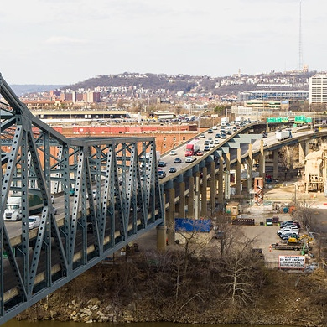
WORKING TOGETHER

Slide 3
Project collaboration
City of Cincinnati Advisory Committee
Camp Washington Business Association
Camp Washington Community Council
Camp Washington Business Association
CHCURC
CUF
Downtown Residents Council
3CDC – Convention Center
Hamilton County Engineer
Queensgate Business Alliance
Cincinnati Regional Business Committee
Cincinnati USA Regional Chamber
Bridge Forward
Port Authority
West End Community Council
West End Business Association
Executive Oversight Committee
Government Agency Partners
City of Cincinnati
Hamilton County
Design Build Team Administration Committee
City of Covington
Note: Executive Oversight Committee and DBPAC each consist of members from ODOT, KYTC, and FHWA
Kenton County
City of Fort Wright
City of Fort Mitchell
Design Build Team
Advisory Committees
Project Advisory Committee
City of Cincinnati
Brent Spence Bridge Corridor Project Management Manual
Defines the City of Cincinnati's goals and objectives, team members and
their roles and responsibilities.
Aesthetics Advisory Committee
Diversity & Inclusion Outreach Committee
Note: see project website for committee members: brentspencebridgecorridor.com
Notes:
Let’s start off with introductions

Slide 4
PROJECT HISTORY

Slide 5
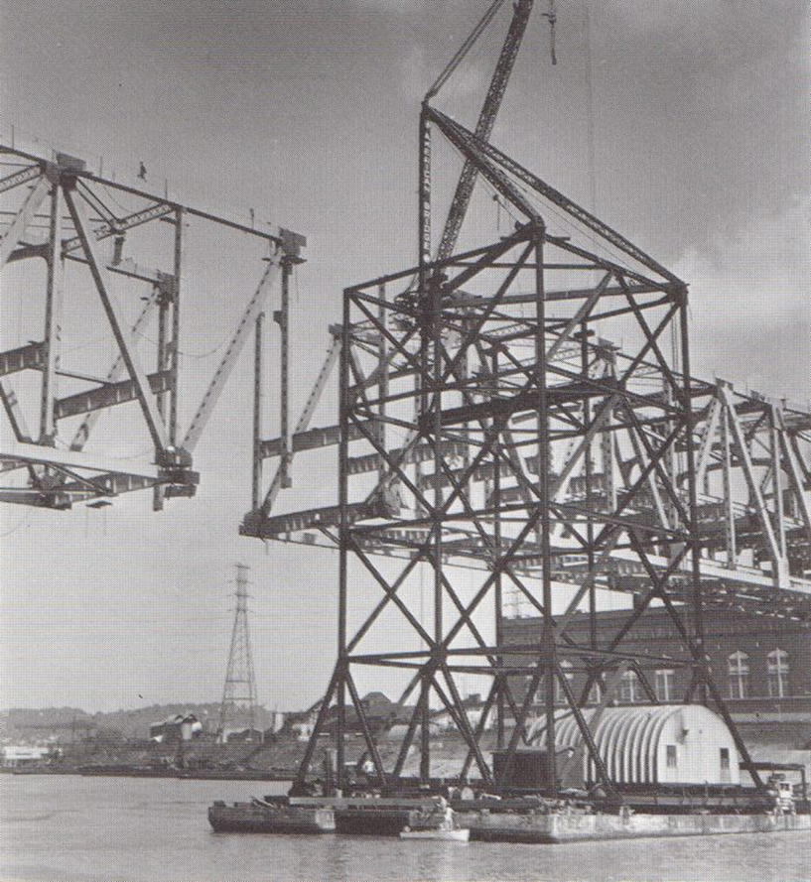
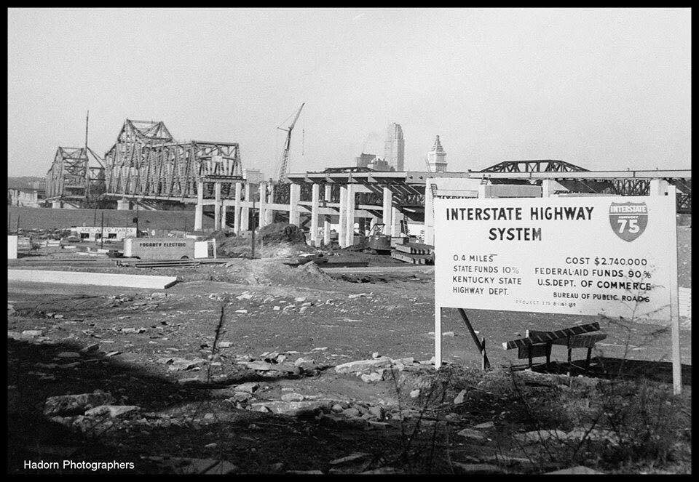
Notes:
Original cost $2.74 Million (0.4 miles) Opened in 1963

Slide 6
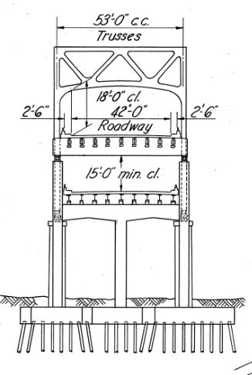
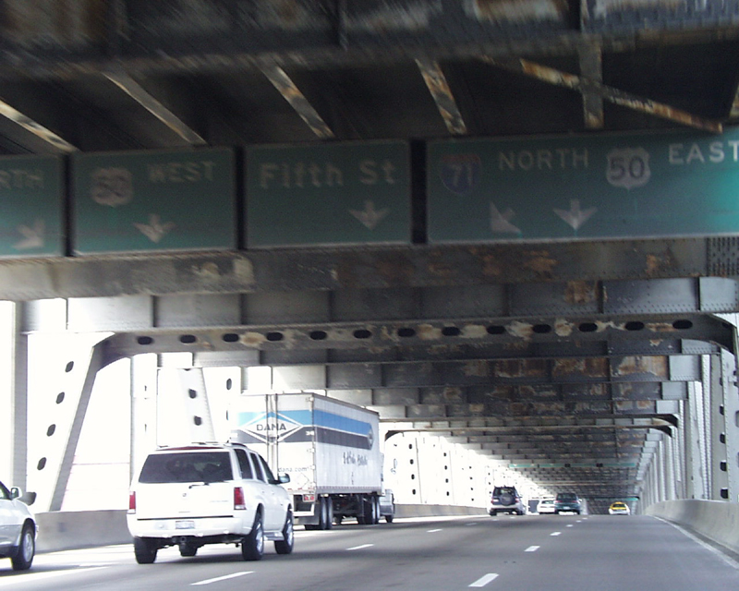
Now: Four
11-feet lanes & 1-foot shoulders
Before: Three 12-feet lanes & 5-feet shoulders
Notes:
Four Lanes Traffic Each Direction
Restriped in 1985
Vertical clearance/signing issues

Slide 7
Project History
“Scoping Study” as part of IR 71 Major Investment Study – 1998
Ohio-Kentucky-Indiana Regional Council of Governments, North South Transportation Initiative (OKI NSTI)- Brent Spence Subcommittee Formed -2000
KYTC Engineering Feasibility Study (EFS) – 2003
Notes:
It has taken quite some time for ODOT and KYTC to get to this point on the project.
The Brent Spence location was first identified as a need for solution in 1998 as part of a regional study of the interstate 71 corridor.
Then again as part of a major investment study of I-75 the need was further defined, and a small subcommittee was formed to begin discussions on the problem and solutions.
In 2003, the states completed a engineering feasibility study that evaluated condition and some potential options. This was funded with limited earmark funds the states received.
In 2005 ODOT and KYTC began the process in earnest to find a solutions to address this bottleneck.

Slide 8
Project History
2000
← 2004 | ODOT & KYTC begin BSB Corridor Project
2005
Alternatives Development & Evaluation
Impact Assessment
Public & Stakeholder Input
2010
2011 | Revive Cincinnati Plan Approved (City of Cincinnati)
2015
2012 | Environmental Approval - Selected Alternative I
Design Refinements
Cost/Impact Reductions
Enhancements
City of Cincinnati updated priorities and goals
2020
2022 | Refined Alternative I - Concept I-W
2023 | City/ODOT continue to refine Concept I-W
2023 | City proposed refinements to Concept I-W

Slide 9
Why is the Project Important
Addresses one of the worst truck bottlenecks in the nation
Improves a critical highway network connecting Florida to Michigan
I-75 carries more than $1B worth of freight every day
Safety and geometric improvements are needed

Slide 10
FEDERAL GRANT AWARD: $1.635 BILLION
Multimodal Project Discretionary (MEGA) Grant Program
Submitted May 2022
Awarded $250M
Bridge Investment Program
Submitted August 9, 2022
Awarded $1.385B
More than 200 letters of support included with applications
Notes:
Since our original FONSI decision in 2012, ODOT and KYTC continued to focus on financing, value engineering, and efficient delivery of the project. The IIJA was the catalyst we needed to get this project completed.

Slide 11
PROJECT OVERVIEW

Slide 12
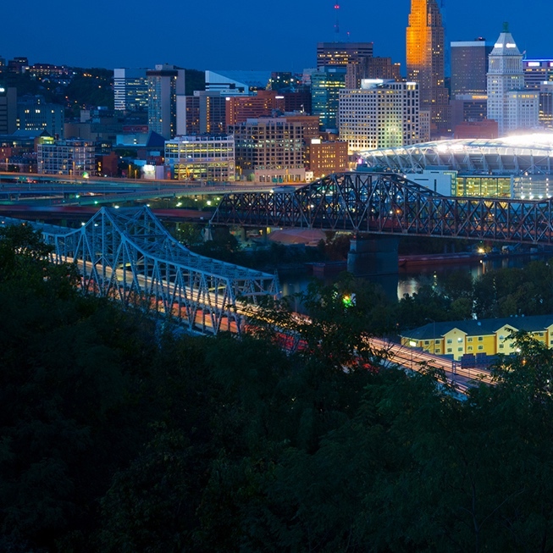
Purpose and Need
Improve traffic flow and level of service
Improve safety
Correct geometric deficiencies
Maintain connections to key regional and national transportation corridors

Slide 13
Project Description

Slide 14
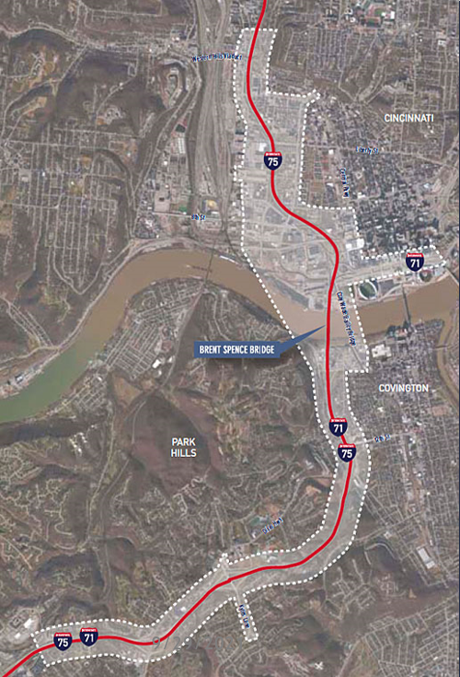
TOTAL PROJECT OVERVIEW
DBB CONTRACTS
Eight-mile corridor from Western Hills Viaduct interchange in OH to Dixie Highway in KY
5 miles of I-71/75 in KY
3 mile of I-75 in OH
New companion Bridge west of the existing Brent Spence Bridge
Updates to existing BSB
Interstate reconstruction, widening and reconfiguring interchanges
Estimated Total Project Amount is $3.6B (for all three segments – Dixie Highway to WHV)
NORTHERN LIMIT
LINN STREET
BRENT SPENCE BRIDGE
PROGRESSIVE DESIGN BUILD CONTRACT
SOUTHERN LIMIT
DIXIE HIGHWAY INTERCHANGE
Notes:
The overall project has been in development since 2005

Slide 15
Project Description
New Companion Bridge
Innovative and cost-effective design
Arch or Cable-Stayed bridge type
Iconic and aesthetically pleasing
On-going coordination with the project Aesthetics Committee
Notes:
The exact design of the new companion bridge has not yet been determined. Two bridge types are being considered to allow the design-team to pursue innovative and cost-effective designs to the greatest extent possible. These include an arch bridge and a cable-stayed bridge. The bridge type will be chosen based on a technical analysis by the design-build team. Regardless of the type that is ultimately chosen, KYTC and ODOT will work with the design-build team to ensure an iconic, aesthetically pleasing bridge is ultimately built. KYTC and ODOT will also continue to coordinate with an Aesthetics Committee that was established to provide local input on the design and appearance of the Brent Spence Bridge Corridor, including the new companion bridge and the existing Brent Spence Bridge. For the bridges, the Aesthetics Committee will provide feedback on features such as lighting, color, tower or pier texture and color, railings, and other features.

Slide 16
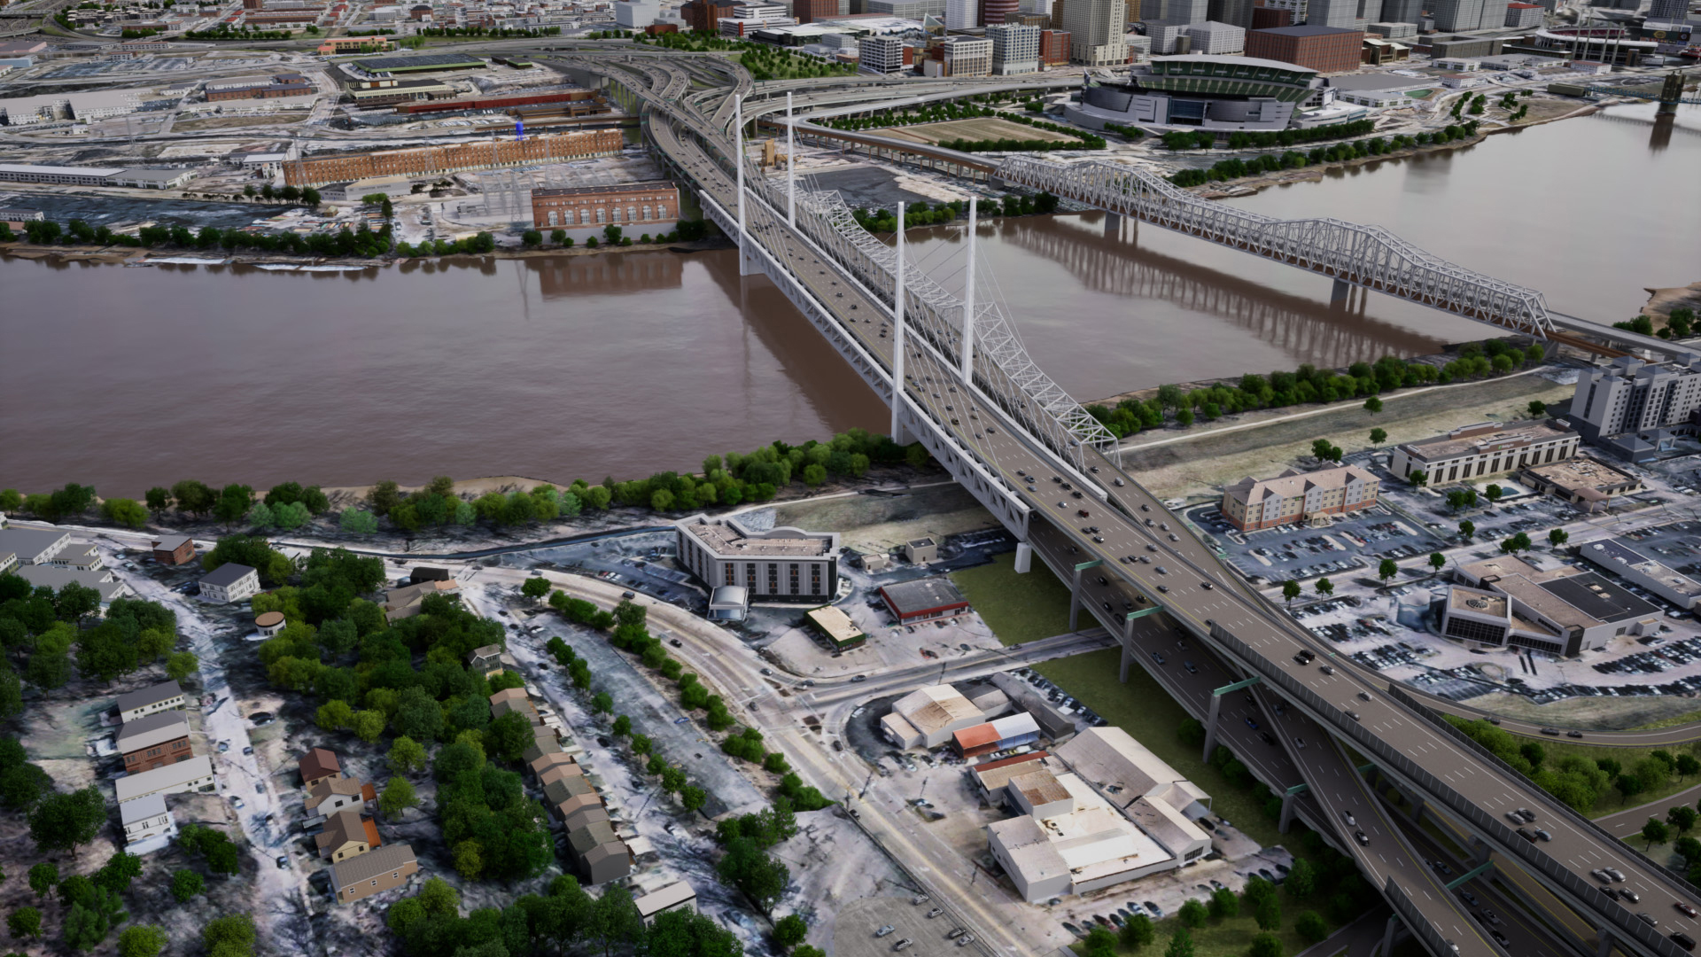
Project Description

Slide 17
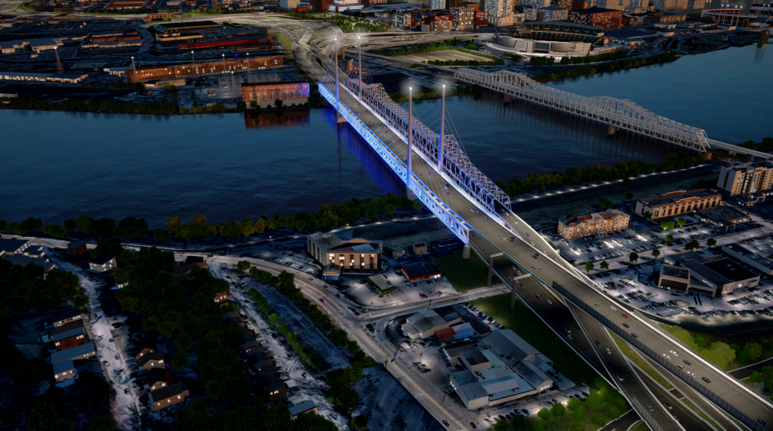

Slide 18
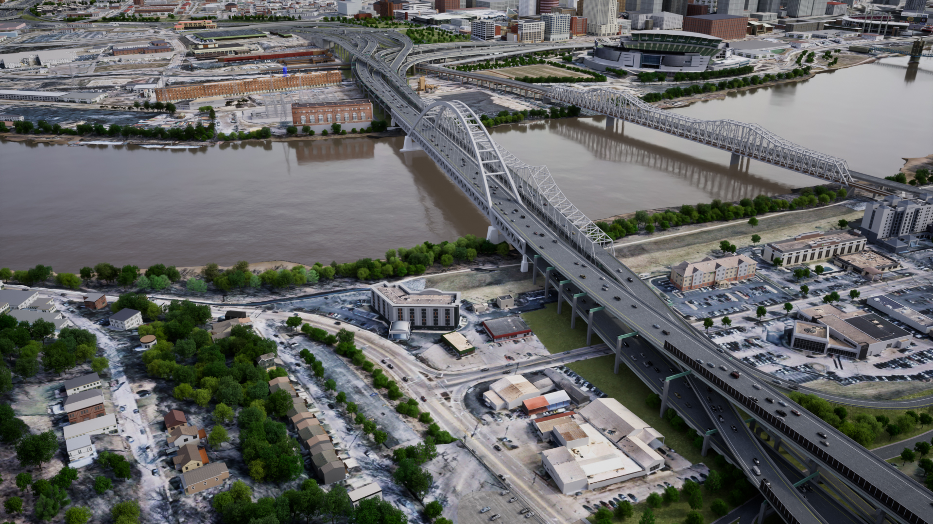
Project Description

Slide 19
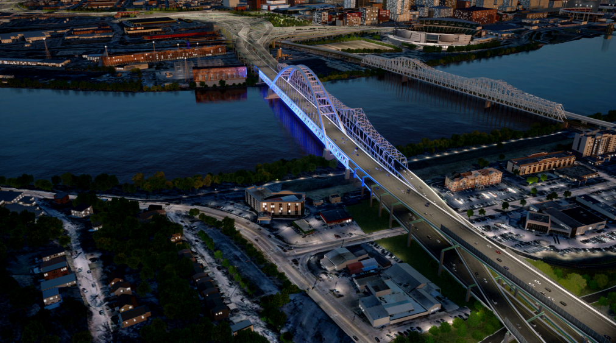

Slide 20
PROGRESSIVE DESIGN BUILD

Slide 21
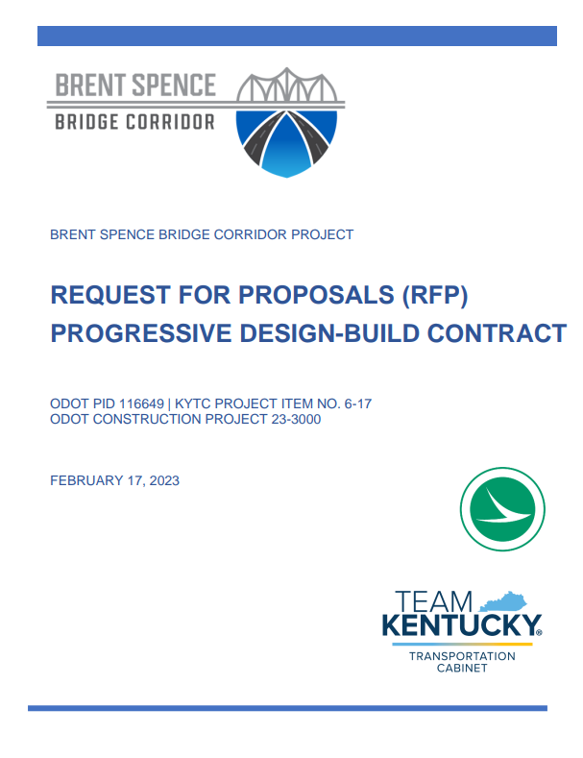
Progressive Design-Build Process
Progressive Design-Build
Selection based on qualifications and pricing approach
Offsets construction market uncertainties
Inflation
Supply chain
Availability of materials

Slide 22
Progressive Design-Build Process
Progressive Design-Build
Prices materials closer to construction
Allows for innovation concepts
Provides more opportunities for outreach
Local agency coordination
Traffic and incident management
Aesthetics

Slide 23
WHAT IS PROGRESSIVE DESIGN BUILD (PDB)?
Request for Proposals
Sub-Phase 1A:
Proof of Concept
Sub-Phase 1B:
Project Development
Phase 2 –
Final Design and Construction

Slide 24
DRAFT SCHEDULE
October: Preconstruction Notice to Proceed
60-day Innovation Period
Spring of 2024: Proof of Concept
Spring of 2025: Phase 1 Complete
Notes:
The Design Build Team will be selected based on qualifications while considering their pricing approach rather than qualifications and just a fixed or lowest bidder price. This approach also allows the project team to work collaboratively on the preferred alternative with the Design Build Team to identify cost-effective solutions that meet the goals of the project and community. It also brings more certainty to our project delivery process and eliminates several variables for those seeking to bid on the project.
The decision to move forward with the Progressive Design Build Procurement will allow ODOT and KYTC to meet our goal of having a Design Build Team selected and project groundbreaking in 2023, with construction activities expected to begin in earnest in 2024.

Slide 25
CONTRACT OBJECTIVES

Slide 26
CONTRACT OBJECTIVES
Maximize the Project scope within the programmed funding amounts through innovation, design optimization and effective risk mitigation;
Achieve effective project delivery;
Open the new Companion Bridge to traffic by July 15, 2029.
Minimize traffic disruption during construction, with minimal detours or diversion of traffic to local streets;
Minimize physical intrusion and impact;
Maximize the public investment in the Project by minimizing the footprint;
Minimize the footprint of the interstate system to maximize potential developable space;
Improve neighborhood connectivity across the interstate;
Build the Project with a context sensitive design that fits within the community;
Provide strong aesthetic value along the Project corridor;
Improve the local road aesthetics when crossing the interstate
Provide opportunities for Workforce Development and DBE utilization;
Create best environmental outcomes;
Design for sustained quality of life;
Notes:
So far, we’ve heard what we’re doing with the project. These objectives focus on how we do it. There’s a lot to read on the screen here, but I like to group these into seven different categories

Slide 27
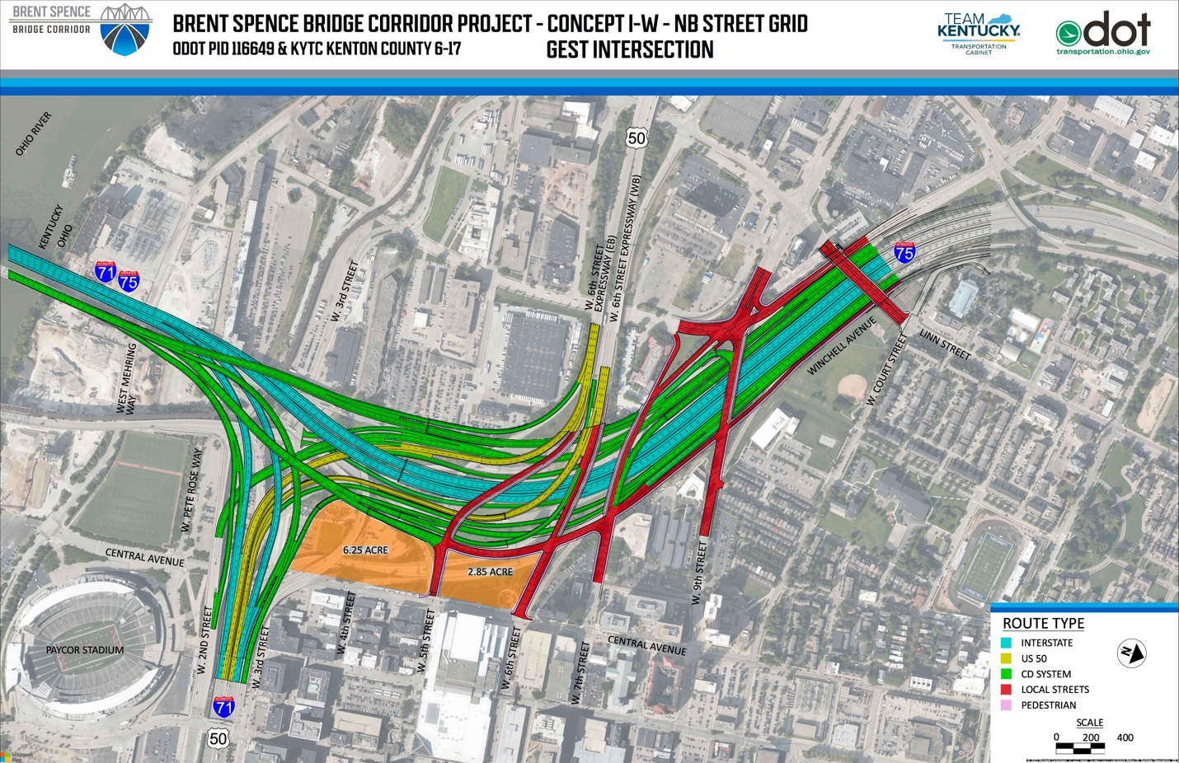
City Proposed Refinements to Concept I-W
Notes:
Shows area of reclaimed land 10 acres

Slide 28
Firefighters Memorial (Looking Southwest) - Ohio
Notes:
Shows area of reclaimed land 10 acres

Slide 29
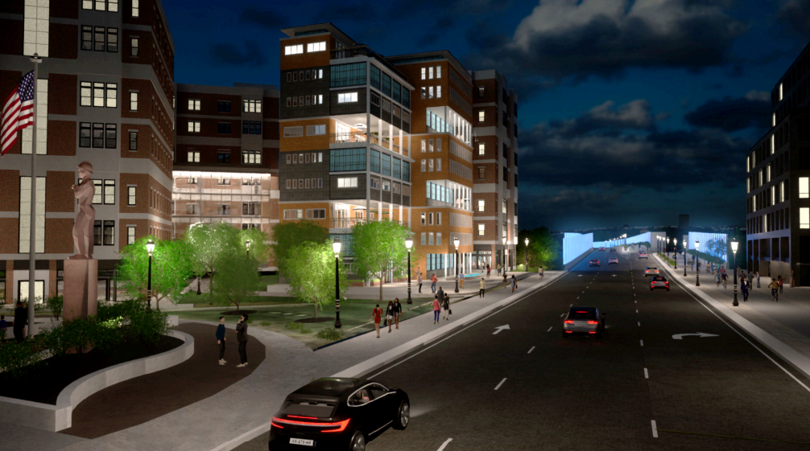
Firefighters Memorial (Looking Southwest) - Ohio

Slide 30
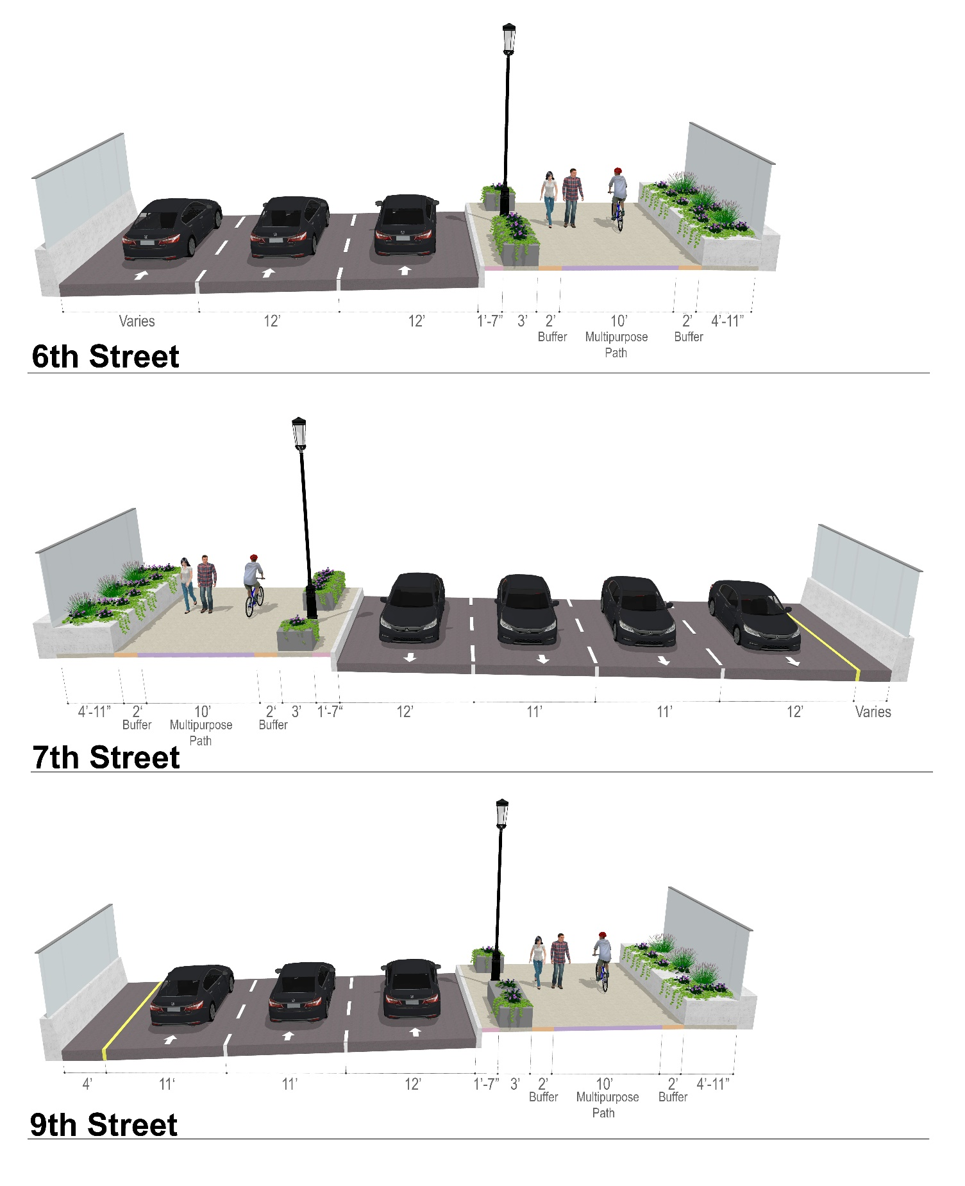
RECONNECTING COMMUNITIES
Connections across I-75
Sidewalks
Shared use paths
Bike lanes
Decks on both sides of Ezzard Charles bridge
New shared use path along Winchell Avenue
Improved connections to local destinations
Notes:
The project will install bicycle and pedestrian infrastructure on connections across I-75 like what is shown here for 6th, 7th, and 9th streets. Pedestrian and bicycle connections will also be provided on Linn Street, Freeman Avenue, Ezzard Charles, Liberty Street, Findlay Street, Bank Street, and Harrison Avenue. In addition, new shared use path will be constructed along Winchell Avenue between 9th Street and Ezzard Charles Drive, including a pedestrian bridge connection to Freeman Avenue. To promote safety for bicycles and pedestrians, the ramp connections with local streets are being designed as lower-speed urban intersections in accordance with City of Cincinnati design standards. The pedestrian and bicycle infrastructure included in the project will improve connectivity to transit, employment, healthcare, cultural, recreational, and commercial destinations.

Slide 31
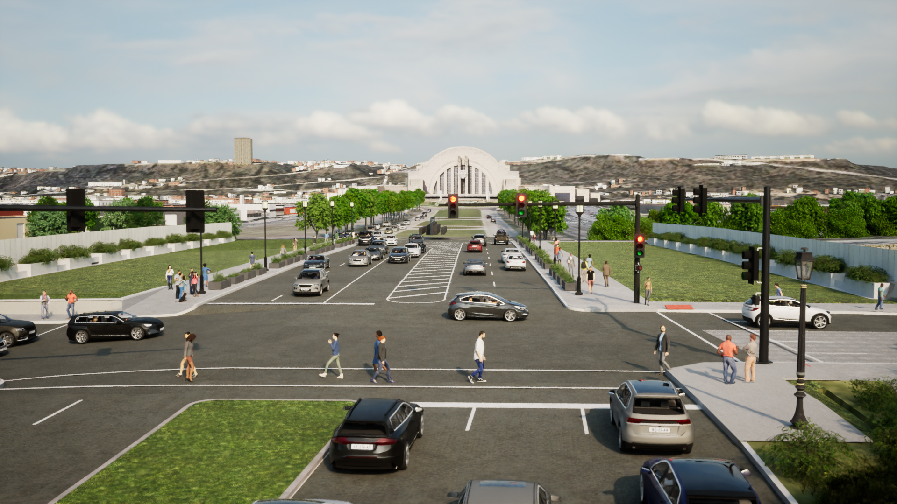
Ezzard Charles Bridge Rendering
Notes:
Point out aesthetic treatments screening and landscaping are similar on all overpasses; shared use path also similar on all overpasses

Slide 32
Public Outreach & Environmental Update

Slide 33
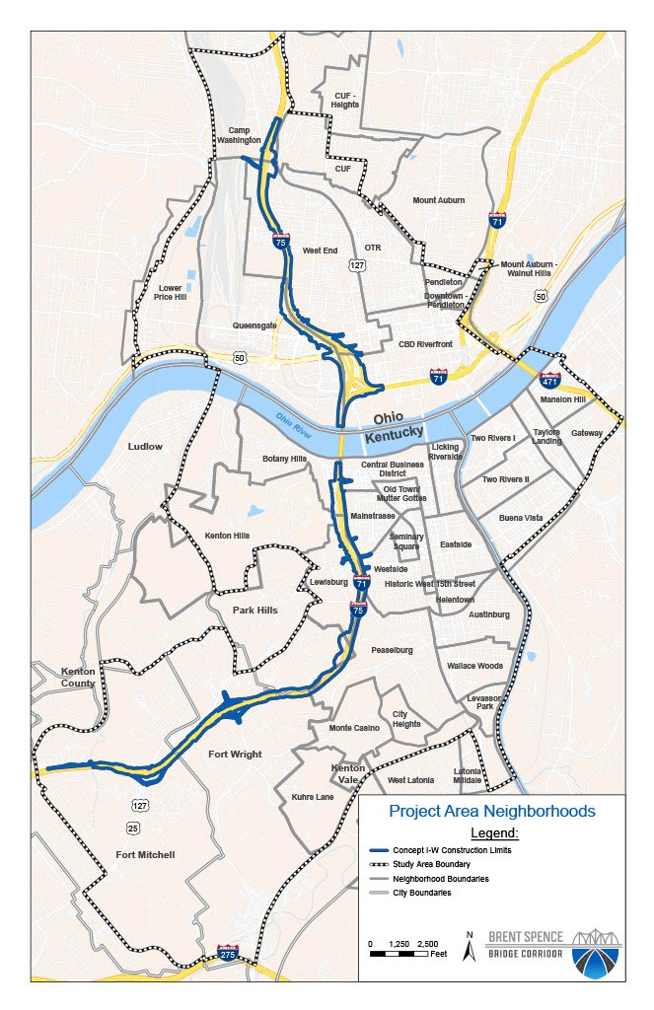
Public Outreach since June of 2022
Neighborhood Meetings
Thirteen neighborhood meetings
Project Open House in both Ohio and Kentucky
In addition:
Held over 75 meetings with individuals/groups, communities, and organizations
Received over 630 Public Comments (neighborhood meetings and website)
Recently Completed Project Status Update Open House (318 attendees)
August 23 in Kentucky
August 24 in Ohio

Slide 34
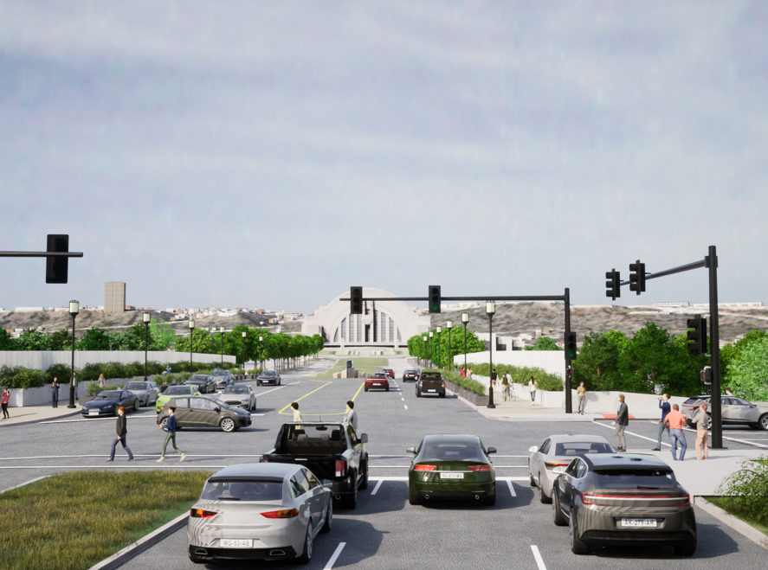
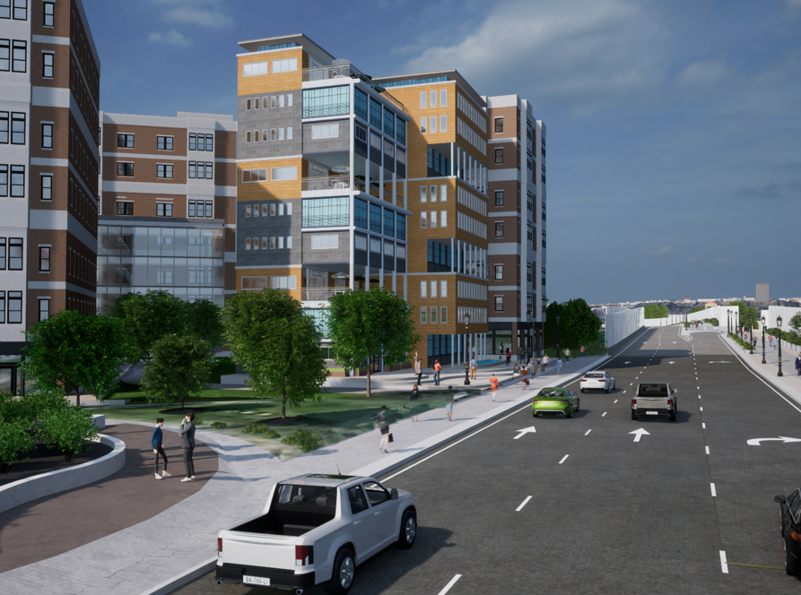
Environmental Process Update
Enhancement Measures
Aesthetic treatments
Pedestrian and bicycle improvements
Noise/visual screening walls
Separating highway runoff
Land for potential redevelopment
Workforce development and training

Slide 35
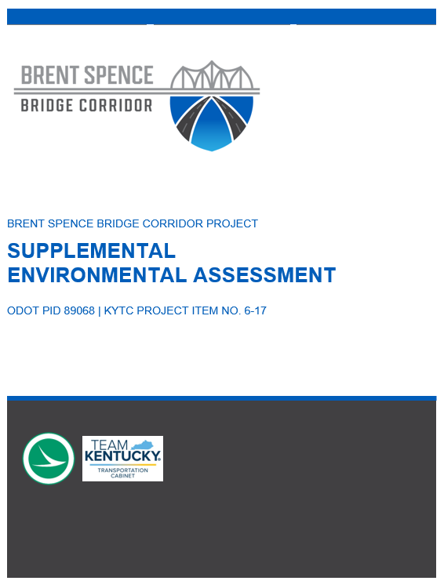
Environmental Process Update
Supplemental EA available for public review – late 2023
Public hearings – late 2023/early 2024
Expected environmental approval – early 2024

Slide 36
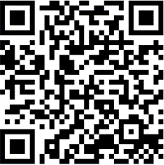
THANK YOU!
For more detailed information or to provide feedback visit:
www.brentspencebridgecorridor.com
BRENTSPENCEBRIDGECORRIDOR.COM

