Slide 1
Citizen Complaint Authority (CCA) Update
March 18, 2021
City of Cincinnati Neighborhoods Committee
Gabe Davis
Executive Director

Slide 2
Overview
2
Mission Statement
Organizational Structure
Investigation Process
Case Scenarios
2020 Significant Accomplishments
2021 Special Report: Police Shootings
Ongoing Challenges & Opportunities
Questions

Slide 3
Mission Statement
3
The Citizen Complaint Authority’s (CCA) mission is to investigate serious interventions by police officers, including, but not limited to discharging of firearms, deaths in custody, and major uses of force, and to review and resolve all citizen complaints in a fair and efficient manner. At a minimum, CCA has jurisdiction over complaints alleging excessive use of force; improper pointing of firearms; improper stops; improper entries, searches and seizures; and discrimination, including racial profiling.

Slide 4
4
CCA Ultimate Goals
Address citizens’ concerns, improve citizens’ perceptions of quality police service in the City of Cincinnati
Improve the delivery of those services

Slide 5
5
Organizational Structure
Director, Investigators and Administrative Professionals
Advisory Board: Up to 7 citizens appointed by Mayor, approved by City Council
Current Voting Board Members:
Mark (Zeek) Childers, Chair
George Pye, Vice Chair
Tim Barr, Jr.
Tracey Johnson
Luz Elena Schemmel
Phyllis Slusher
Wanda Spivey

Slide 6
6
City Manager
Paula Boggs Muething
CCA Director
Gabriel Davis
Chief Investigator
Dena Brown
Investigator
Jessalyn Goodman
Senior Administrative Specialist
Michelle Bonner
CCA Board
Administrative Specialist
Heidi Woods
Investigator
Ike Ekeke
Investigator
Jonathan Batista
Investigator
Morgan Givens

Slide 7
COMPLAINT AND INVESTIGATION PROCESS
7

Slide 8
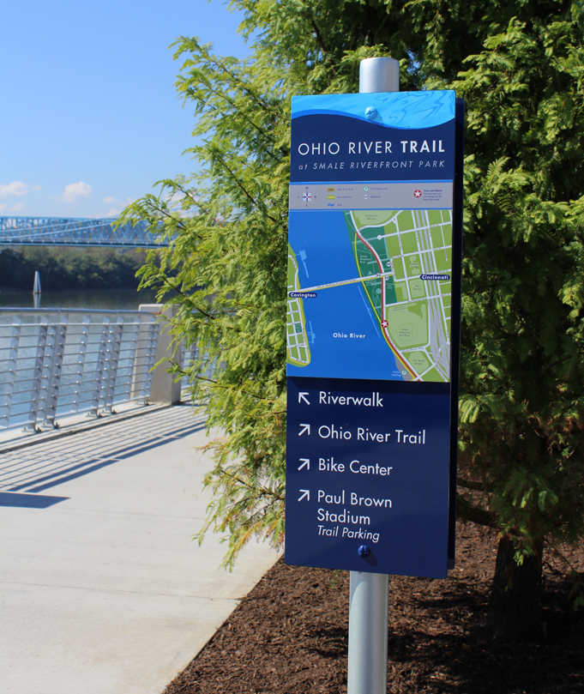
8
Complaint and Investigation Process
Summary of Steps:
Intake
Complaint is filed
Investigation
Review, Analysis and Determination
CCA Findings & Recommendations
Board Review
City Manager’s Final Decision
Final Decision Sent to Chief of Police

Slide 9
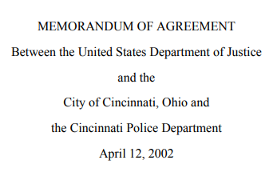
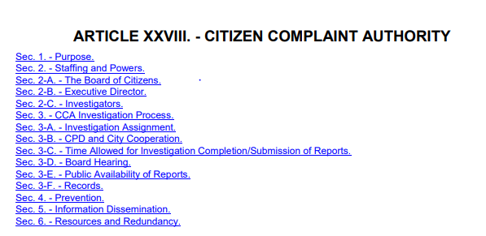
9
Investigations
Collaborative Agreement/Article XXVIII, Section 3
Memorandum of Agreement, Section 6 (paragraphs 35-56)

Slide 10
10
What complaints does CCA investigate?
$14.4
$14.6
Complaints Investigated by CCA
Discrimination/Racial Profiling
Improper Entry, Search and Seizure
Excessive Use of Force
Improper Stop
Improper Pointing of Firearm
Discharge of Firearm
Death in custody
Secondary Causes of Action Investigated by CCA
Discourtesy or Unprofessional Attitude
Lack of Proper Service
Improper Procedure
Harassment
Abuse of Authority
$11.4
$11.1
$9.0
$8.5

Slide 11
11
CCA Investigations
Utilize an investigative protocol:
Review the allegations
Gather, review and analyze evidence
Interview all parties involved and witnesses
Interpret all applicable laws, regulations, policies, procedures, decisions, standard practices and training
Analyze information, using the preponderance of evidence burden of proof
Provide final analysis, conclusion and disposition
Recommend action (when necessary)
City
CAP Rehab
Carry-Over Grants
Grants

Slide 12
12
CCA Investigations
Administrative investigations
Burden of proof = preponderance of evidence Does 51% of the evidence favor one side or the other?
90 days – Investigation completed, unless extenuating circumstances

Slide 13
CCA Investigations
13
CCA’s findings will be one of the following (consistent with MOA):
Unfounded - where the investigation determined no facts to support that the incident complained of actually occurred;
Sustained - where the person's allegation is supported by sufficient evidence to determine that the incident occurred and the actions of the officer were improper;
Not Sustained - where there are insufficient facts to decide whether the alleged misconduct occurred; or
Exonerated - where a preponderance of the evidence shows that the alleged conduct did occur but did not violate CPD policies, procedures, or training.

Slide 14
Case Scenarios
14

Slide 15
15
Case Scenario
Complaint # | 18185
Complainant | Julia Jeffries
CCA Investigator | Dena Brown
CCA Findings | Complainant Marcella Juergens Sergeant Nathan Asbury Entry (Residence) - NOT SUSTAINED Officers Marc Schildmeyer and Deon Mack, Sergeant Nathan Asbury Procedure (Consent to Search) – SUSTAINED Officer Marc Schildmeyer Improper Search (Residence) - SUSTAINED Officers Deon Mack and Cian McGrath, Sergeant Nathan Asbury Improper Search (Residence) - NOT SUSTAINED Officers Cian McGrath, Deon Mack and Marc Schildmeyer Procedure (BWC – Turned off Early) – SUSTAINED

Slide 16
16
Case Scenario
Complaint
On September 14, 2018, Ms. Julia Jeffries alleged that Cincinnati Police Officers stopped her son in a vehicle and took him into custody at gunpoint . . . Further, Ms. Jeffries alleged that police officers improperly entered and searched the residence of her mother, Ms. Marcella Juergens.

Slide 17
17
Case Scenario
Analysis
Police obtained written consent for the officers to conduct a search . . . .
However, CPD training provides that a consent search should be limited to only those places and things that the person expressly or impliedly authorized to be searched. . . .
BWC footage showed that, prior to signing the form, Ms. Juergens indicated her belief that the officers only intended to search Mr. Jeffries’s bedroom. When she attempted to clarify this point with” the lead officer, that officer “responded, ‘Just his room, because he told us,’ and then [that officer] added that they would ‘search his room and anything out in the open’ that may harm Ms. Juergens or the officers. Only then did Ms. Juergens sign the Consent to Search Form.

Slide 18
18
Case Scenario
Analysis
Rather than limit the search of the residence to Mr. Jeffries’s bedroom and to anything out in the open as [the officer] stated, police proceeded to search the entire residence, going inside of drawers and cabinets.
Several BWCs were turned off too early, and before the completion of the search.
Notes:
From Report:
“Accordingly, the evidence indicates that Ms. Juergens agreed to the search with the understanding that the officers planned to search only Mr. Jeffries’s bedroom and areas out in the open for items in plain view, and that her limits were ignored. Therefore, because the search of the residence went beyond the scope of the consent given . . . CCA determined the officers’ search of the residence was not within CPD’s policy, procedure, and training.”

Slide 19
19
Case Scenario
Complaint # | 20048
Complainant | Ladon Mitchell
CCA Investigator | Jessalyn Goodman
CCA Findings | Officer Alyssa Twehues Improper Stop – EXONERATED Officers Alyssa Twehues, Clinton Butler, and Corey Gould Improper Search – EXONERATED Officers Alyssa Twehues, Clinton Butler, and Corey Gould Discrimination – UNFOUNDED

Slide 20
20
Case Scenario
Complaint
On January 23, 2019, Mr. Mitchell was pulled over by Cincinnati Police Officers for traffic violations which included having dark window tint and a covered license plate. Mr. Mitchell believed it was a baseless traffic stop.
A Canine Officer responded. Mr. Mitchell did not believe there was any basis to request a canine, and that the stop took too long. After the canine sniffed around Mr. Mitchell’s vehicle, police allegedly “illegally searched” it.
Mr. Mitchell believed that the officers utilized racial profiling as the basis for the traffic stop and subsequent search of his property.

Slide 21
21
Case Scenario
Analysis
BWC footage confirmed the vehicle appeared to have heavy dark window tint, which corroborated the officers’ reports. CPD policy permits citations for tint violations based on an officer’s observations alone, without the need for a tint meter reading.
CPD policy states that an officer does not need reasonable suspicion for a dog to sniff the outside of an automobile. The time awaiting the canine’s arrival, as well as the perimeter sniff of the vehicle, was approximately 17 minutes total, which was reasonable under the law.
CPD policy also states that if the narcotic canine alerts to contraband inside the vehicle, probable cause exists to search the entire vehicle and any containers within the passenger area without a search warrant.

Slide 22
22
Case Scenario
Analysis
While the existence of genuine and provable traffic infractions alone would not be enough to defeat an accusation of racial profiling, given that race could still be a factor in an officer’s decision to stop an offending driver, in this case we have more than just a provable traffic infraction. The officers told CCA that information from neighborhood reports of drug dealing involving a vehicle matching the description of Mr. Mitchell’s vehicle was the controlling factor that led to the stop. BWC chatter corroborated that assertion.
The presence of heavy tints on the car minimized the opportunity for the officers to have observed that Mr. Mitchell was Black at the time of the stop.
And no other aspects of the officers’ encounter with Mr. Mitchell (such as the search of his car) violated policy, procedure, or training.

Slide 23
23
2020 Accomplishments
CCA commenced 75 new investigations based on citizen complaints. In addition, CCA referred 174 complaints to the Cincinnati Police Department (CPD) for investigation after screening and reviewing those complaints.
CCA completed 44 investigations in and issued 305 findings associated with those cases.
CCA responded to the scene of all officer-involved shootings (2 total).
CCA responded to the scene of all cases involving deaths in police custody (2 total).

Slide 24
24
2020 Accomplishments
CCA collaborated with CPD on CPD’s periodic review of its use of force procedures, during which CCA issued multiple recommendations regarding CPD’s proposed policy revisions.
CCA issued 16 recommendations and 11 observations to the CPD. Those recommendations addressed police policy and training, including the following topics: investigatory stops, searches and frisks, Body Worn Camera (BWC) evidentiary access, BWC use policy, CPD’s Use of Force Review Board, TASER deployment, defining harassment as an allegation, and more.
Notes:
Patterns Report examined a 3-year period and tracked (i) officers who have received a high number of complaints, (ii) repeat complainants, and (iii) the top circumstances that formed the bases for complaints.

Slide 25
25
2020 Accomplishments
CCA participated and led 19 community engagements and trainings, reaching approximately 270 people.
CCA provided public with opportunity to participate in CCA’s monthly Board Meetings virtually, for the first time in CCA’s history.
CCA published its 2019 Annual Report, which summarized CCA’s activities and outcomes for the 2019 calendar year.
CCA published its 2019 Patterns Report.
Notes:
Board Meeting revamp:
Increased opportunities for community to…
(i) offer comments and questions during monthly Board Meetings; (ii) provide qualitative feedback to CCA’s on its efficacy; and (iii) become educated about issues related to community concerns through the use of guest speakers

Slide 26
26
2020 Accomplishments
CCA liaised with and provided guidance to public officials and representatives from other cities interested in creating an oversight agency or improving existing oversight functions.
CCA hired, onboarded, and trained 3 new experienced and diverse Investigators, including a former NYPD detective fluent in Spanish, a former Cleveland prosecutor, and a counterintelligence investigator from the U.S. Intelligence Community.

Slide 27
27
2021 Special Report: Police Shootings
Officer Involved Firearm Discharge Report (2018-2019)
8 shootings investigated
2 citizens were fatally wounded and 3 suffered non-fatal injuries. One police officer suffered a non-fatal injury
Approximately 67% of the persons who were subject to an intentional firearm discharge either appear to have been suffering from mental health issues at the time of the shooting, or reportedly were suffering from such issues.
5 unique recommendations
Mental health risk assessment
Charging mental health suspects
Medical aid to wounded suspects
CPD Review Board use
CPD Review Board scope

Slide 28
28
Challenges
Investigations backlog
Limited capacity to fulfill non-investigatory duties
Notes:
Plan: More investigators, law interns, summarized reports, ambitious targets
Pursuant to Article 28, CCA should have a minimum of 5 investigators. For at least 10 years, CCA operated with no more than 3 investigators, and in some months, operated with only 2 investigators. This years-long staffing shortage has led to a massive backlog that will take a significant infusion of new staffing in order to eliminate the problem and bring CCA into compliance with the law.
Based on past performance, CCA closes appx 2 cases per investigator, per month. Based on those figures, current staffing would permit us to close 10 cases per month total once staff hired in Dec 2020 are fully trained (expected by summer 2021). Thus, because CCA gets appx 6-7 new cases per month, we would not be able to eliminate backlog with current staffing alone until as late as 2024.

Slide 29
29
Opportunities: Community Engagement
Current Resources:
Engagement via Board Meetings
Largely ad-hoc outreach and limited one-on-one engagements with CCA leadership
Presentations in some communities and schools
Additional Resources:
Presentations in all 52 Cincinnati neighborhoods
CCA Ambassador Program to organize outreach, strategically plan, and engage volunteers
Community listening sessions
Grassroots presence at community events
Director’s Officer Hours
Increased complainant support
Engagement via Board Meetings
Notes:
CCA Ambassador program
routine engagement and dissemination,
mediation

Slide 30
30
Opportunities: Mediation
Current Resources:
Refer cases to CPD for Citizen Complaint Resolution Process (CCRP)
Additional Resources:
Collaborate with CPD to strengthen CCRP
Adopt restorative justice, mediation-driven approach to some citizen complaints
Utilize national best practices, including potential use of community or paid mediators
Potential use of CCA personnel to staff or monitor mediations

Slide 31
31
Opportunities: Complaint Prevention via Pattern and Data Analysis
Current Resources:
Annual Patterns Report
Annual Report
Case recommendations
Additional Resources:
Bi-annual or quarterly reports on patterns and recommendations
Deeper analysis of pattern circumstances and findings trends
Recommendations informed by advanced policy research
Collaborative problem-solving efforts driven by complaint data and law enforcement data
Notes:
Complaint prevention
Examine circumstances that lead to complaints
Collaborate on problem solving with CPD
Aid in ensuring policy recommendations reflect best practices

Slide 32
Questions?
32
Citizen Complaint Authority
805 Central Avenue, Suite 222
Cincinnati, OH 45202
Telephone: 513.352.1600
Facsimile: 513.352.3158
Website: www.cincinnati-oh.gov/ccia/
Email: CCA@cincinnati-oh.gov

