Slide 1
Combatting Corruption
Campaign Finance,
the First Amendment
&
Restoring the Public’s Trust

Slide 2
Chris Bryant
&
Evan Gildenblatt
chris.bryant@uc.edu

Slide 3
Roadmap
Buckley v. Valeo (1976)
  Distinction between expenditures & contributions
  Holding
Citizens United (2010)
  Issues
  Holding
  Controversy
  Fall out

Slide 4
Roadmap, ii
“Pay to Play” Campaign Finance Restrictions
  Wagner v. FEC (D.C. Cir. 2015) (en banc)
  other cases
Opportunities & Challenges
EG: Lessons from Texas
  Tools for restoring the public’s trust

Slide 5
Buckley v. Valeo
1976

Slide 6
Buckley v. Valeo (1976)
Expenditure limits
Contribution limits
Severely infringe free speech
  Limits amount of expression
  $ needed for mass comm.
Less related to corruption
  Lack of coordination w/ cand.
  Of less value to candidate
  And less opp. for deal
Only marginal burden on right
  Really about “association”
    Which is still allowed
    Amount shows only “intensity”
Greater risk of corruption
  Of great value to candidate
  Interaction = opp. for deal
Notes:
A restriction on the amount of money a person or group can spend on political communication during a campaign necessarily reduces the quantity of expression by restricting the number of issues discussed, the depth of their exploration, and the size of the audience reached. This is because virtually every means of communicating ideas in today’s mass society requires the expenditure of money. The distribution of the humblest handbill or leaf-let entails printing, paper, and circulation costs. Speeches and rallies generally necessitate hiring a hall and publicizing the event. The electorate’s increasing dependence on television, radio, and other mass media for news and information has made these expensive modes of communication indispensable instruments of effective political speech.
A contribution serves as a general expression of support for the candidate and his views, but does not communicate the underlying basis for the support. The quantity of communication by the contributor does not increase perceptibly with the size of his contribution, since the expression rests solely on the undifferentiated, symbolic act of contributing. At most, the size of the contribution provides a very rough index of the intensity of the contributor’s support for the candidate. A limitation on the amount of money a per-son may give to a candidate or campaign organization thus involves little direct restraint on his political communication, for it permits the symbolic expression of support evidenced by a contribution but does not in any way infringe the contributor’s freedom to discuss candidates and issues. While contributions may result in political expression if spent by a candidate or an association to present views to the voters, the transformation of contrbutions into political debate involves speech by someone other than the contributor. . . .

Slide 7
Buckley v. Valeo (1976)
Expenditure limits
Contribution limits
Severely infringe free speech
  Direct limit on expression
  $ needed
Less related to corruption
  Lack of coordination w/ cand.
  Means of les value to cand.
  And less opp. for deal
Only marginal burden on right
  Really about “association”
    Which is still allowed
    Amount shows only “intensity”
Greater risk of corruption
  Of great value to candidate
  Interaction = opp. for deal
ALSO UPHOLDS DISCLOSURE
Notes:
A restriction on the amount of money a person or group can spend on political communication during a campaign necessarily reduces the quantity of expression by restricting the number of issues discussed, the depth of their exploration, and the size of the audience reached. This is because virtually every means of communicating ideas in today’s mass society requires the expenditure of money. The distribution of the humblest handbill or leaf-let entails printing, paper, and circulation costs. Speeches and rallies generally necessitate hiring a hall and publicizing the event. The electorate’s increasing dependence on television, radio, and other mass media for news and information has made these expensive modes of communication indispensable instruments of effective political speech.
A contribution serves as a general expression of support for the candidate and his views, but does not communicate the underlying basis for the support. The quantity of communication by the contributor does not increase perceptibly with the size of his contribution, since the expression rests solely on the undifferentiated, symbolic act of contributing. At most, the size of the contribution provides a very rough index of the intensity of the contributor’s support for the candidate. A limitation on the amount of money a per-son may give to a candidate or campaign organization thus involves little direct restraint on his political communication, for it permits the symbolic expression of support evidenced by a contribution but does not in any way infringe the contributor’s freedom to discuss candidates and issues. While contributions may result in political expression if spent by a candidate or an association to present views to the voters, the transformation of contrbutions into political debate involves speech by someone other than the contributor. . . .

Slide 8
Buckley v. Valeo (1976)
Expenditure limits
Contribution limits
Severely infringe free speech
  Limits amount of expression
  $ needed for mass comm.
Less related to corruption
  Lack of coordination w/ cand.
  Of less value to candidate
  And less opp. for deal
Only marginal burden on right
  Really about “association”
    Which is still allowed
    Amount shows only “intensity”
Greater risk of corruption
  Of great value to candidate
  Interaction = opp. for deal
Notes:
A restriction on the amount of money a person or group can spend on political communication during a campaign necessarily reduces the quantity of expression by restricting the number of issues discussed, the depth of their exploration, and the size of the audience reached. This is because virtually every means of communicating ideas in today’s mass society requires the expenditure of money. The distribution of the humblest handbill or leaf-let entails printing, paper, and circulation costs. Speeches and rallies generally necessitate hiring a hall and publicizing the event. The electorate’s increasing dependence on television, radio, and other mass media for news and information has made these expensive modes of communication indispensable instruments of effective political speech.
A contribution serves as a general expression of support for the candidate and his views, but does not communicate the underlying basis for the support. The quantity of communication by the contributor does not increase perceptibly with the size of his contribution, since the expression rests solely on the undifferentiated, symbolic act of contributing. At most, the size of the contribution provides a very rough index of the intensity of the contributor’s support for the candidate. A limitation on the amount of money a per-son may give to a candidate or campaign organization thus involves little direct restraint on his political communication, for it permits the symbolic expression of support evidenced by a contribution but does not in any way infringe the contributor’s freedom to discuss candidates and issues. While contributions may result in political expression if spent by a candidate or an association to present views to the voters, the transformation of contrbutions into political debate involves speech by someone other than the contributor. . . .

Slide 9
Buckley v. Valeo (1976)
Expenditure limits
Contribution limits
Severely infringe free speech
  Direct limit on expression
  $ needed
Less related to corruption
  Lack of coordination w/ cand.
  Means of les value to cand.
  And less opp. for deal
Only marginal burden on right
  Really about “association”
    Which is still allowed
    Amount shows only “intensity”
Greater risk of corruption
  Of great value to candidate
  Interaction = opp. for deal
ALSO UPHOLDS DISCLOSURE
Notes:
A restriction on the amount of money a person or group can spend on political communication during a campaign necessarily reduces the quantity of expression by restricting the number of issues discussed, the depth of their exploration, and the size of the audience reached. This is because virtually every means of communicating ideas in today’s mass society requires the expenditure of money. The distribution of the humblest handbill or leaf-let entails printing, paper, and circulation costs. Speeches and rallies generally necessitate hiring a hall and publicizing the event. The electorate’s increasing dependence on television, radio, and other mass media for news and information has made these expensive modes of communication indispensable instruments of effective political speech.
A contribution serves as a general expression of support for the candidate and his views, but does not communicate the underlying basis for the support. The quantity of communication by the contributor does not increase perceptibly with the size of his contribution, since the expression rests solely on the undifferentiated, symbolic act of contributing. At most, the size of the contribution provides a very rough index of the intensity of the contributor’s support for the candidate. A limitation on the amount of money a per-son may give to a candidate or campaign organization thus involves little direct restraint on his political communication, for it permits the symbolic expression of support evidenced by a contribution but does not in any way infringe the contributor’s freedom to discuss candidates and issues. While contributions may result in political expression if spent by a candidate or an association to present views to the voters, the transformation of contrbutions into political debate involves speech by someone other than the contributor. . . .

Slide 10
Buckley v. Valeo (1976)
Expenditure limits
Contribution limits
Severely infringe free speech
  Direct limit on expression
  $ needed
Less related to corruption
  Lack of coordination w/ cand.
  Means of les value to cand.
  And less opp. for deal
Only marginal burden on right
  Really about “association”
    Which is still allowed
    Amount shows only “intensity”
Greater risk of corruption
  Of great value to candidate
  Interaction = opp. for deal
ALSO UPHOLDS DISCLOSURE
Notes:
A restriction on the amount of money a person or group can spend on political communication during a campaign necessarily reduces the quantity of expression by restricting the number of issues discussed, the depth of their exploration, and the size of the audience reached. This is because virtually every means of communicating ideas in today’s mass society requires the expenditure of money. The distribution of the humblest handbill or leaf-let entails printing, paper, and circulation costs. Speeches and rallies generally necessitate hiring a hall and publicizing the event. The electorate’s increasing dependence on television, radio, and other mass media for news and information has made these expensive modes of communication indispensable instruments of effective political speech.
A contribution serves as a general expression of support for the candidate and his views, but does not communicate the underlying basis for the support. The quantity of communication by the contributor does not increase perceptibly with the size of his contribution, since the expression rests solely on the undifferentiated, symbolic act of contributing. At most, the size of the contribution provides a very rough index of the intensity of the contributor’s support for the candidate. A limitation on the amount of money a per-son may give to a candidate or campaign organization thus involves little direct restraint on his political communication, for it permits the symbolic expression of support evidenced by a contribution but does not in any way infringe the contributor’s freedom to discuss candidates and issues. While contributions may result in political expression if spent by a candidate or an association to present views to the voters, the transformation of contrbutions into political debate involves speech by someone other than the contributor. . . .

Slide 11
Buckley on Equalizing
“[T]he concept that government may restrict the speech of some elements of our society in order to enhance the relative voice of others is wholly foreign to the First Amendment.”

Slide 12
Where’s the problem(s)?
$$$
corruption?
Ads
Votes

Slide 13
Austin on “Anti-distortion”
MI had a compelling governmental interest in preventing “the corrosive and distorting effects of immense aggregations of wealth that are accumulated with the help of the corporate form and that have little or no correlation to the public’s support for the corporation’s political ideas.”

Slide 14
Citizens United
2010

Slide 15
Section 441b
Prohibits EXPENDITURE of corporation’s $$$
  “Express advocacy” (1947; Truman’s veto) AND
    “magic words”
  (after 2002) “electioneering communication”
    Broadcast, cable & satellite
    Clearly identifiable candidate
    W/in 60 days of general or 30 days of primary election

Slide 16
Citizens United
NON-profit corporation
  About $12 M annual budget
  Mostly from individuals; some from for-profits
Conservative advocacy group
January 2008: Hillary: The Movie
  Sought additional distribution in cable VOD
Notes:
. Hillary was released in theaters and on DVD, but Citizens United wanted to increase distribution by making it available through video-on-demand.
Video-on-demand allows digital cable subscribers to select programming from various menus, including movies, television shows, sports, news, and music. The viewer can watch the program at any time and can elect to rewind or pause the program. In December 2007, a cable company offered, for a payment of $1.2 million, to make Hillary available on a video-on-demand channel called “Elections ‘08.” App. 255a–257a. Some video-on-demand services require viewers to pay a small fee to view a selected program, but here the proposal was to make Hillary available to viewers free of charge.

Slide 17
Citizens United - Majority
Rejected anti-distortion rationale
  Form of forbidden “equalizing”
  Proves too much
Corruption concerns = individual expenditures
  Disclosure & bribery laws sufficient in both cases
  “Corruption” = ONLY quid pro quo
No legal difference between corps & people

Slide 18
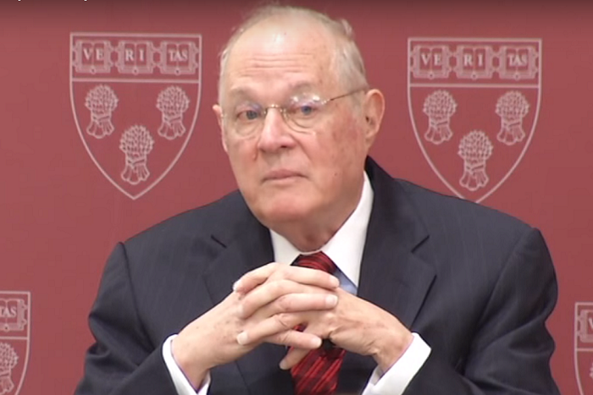
Justice Kennedy

Slide 19
Kennedy on Anti-distortion
“All speakers, including individuals and the media, use money amassed from the economic marketplace to fund their speech. The First Amendment protects the resulting speech, even if it was enabled by economic transactions with persons or entities who disagree with the speaker’s ideas.”
Notes:
If the First Amendment has any force, it prohibits Congress from fining or jailing citizens, or associations of citizens, for simply engaging in political speech. If the antidistortion rationale were to be accepted, however, it would permit Government to ban political speech simply because the speaker is an association that has taken on the corporate form. The Government contends that Austin permits it to ban corporate expenditures for almost all forms of communication stemming from a corporation. See Part II–E, supra; Tr. of Oral Arg. 66 (Sept. 9, 2009); see also id., at 26–31 (Mar. 24, 2009). If Austin were correct, the Government could prohibit a corporation from expressing political views in media beyond those presented here, such as by printing books. The Government responds “that the FEC has never applied this statute to a book,” and if it did, “there would be quite [a] good as-applied challenge.” Tr. of Oral Arg. 65 (Sept. 9, 2009). This troubling assertion of brooding governmental power cannot be reconciled with the confidence and stability in civic discourse that the First Amendment must secure.
Either as support for its antidistortion rationale or as a further argument, the Austin majority undertook to distinguish *351 wealthy individuals from corporations on the ground that “[s]tate law grants corporations special advantages—such as limited liability, perpetual life, and favorable treatment of the accumulation and distribution of assets.” 494 U.S., at 658–659, 110 S.Ct. 1391. This does not suffice, however, to allow laws prohibiting speech. “It is rudimentary that the State cannot exact as the price of those special advantages the forfeiture of First Amendment rights.” Id., at 680, 110 S.Ct. 1391 (SCALIA, J., dissenting).

Slide 20
Kennedy on “Corruption”
“The fact that speakers may have influence over or access to elected officials does not mean that these officials are corrupt.”
Notes:
26 States do not restrict independent expenditures
When Buckley identified a sufficiently important governmental interest in preventing corruption or the appearance of corruption, that interest was limited to quid pro quo corruption.
“Favoritism and influence are not ... avoidable in representative politics. It is in the nature of an elected representative to favor certain policies, and, by necessary corollary, to favor the voters and contributors who support those policies. It is well understood that a substantial and legitimate reason, if not the only reason, to cast a vote for, or to make a contribution to, one candidate over another is that the candidate will respond by producing those political outcomes the supporter favors. Democracy is premised on responsiveness.” McConnell, 540 U.S., at 297, 124 S.Ct. 619 (opinion of KENNEDY, J.).
Reliance on a “generic favoritism or influence theory ... is at odds with standard First Amendment analyses because it is unbounded and susceptible to no limiting principle.”
only scant evidence that independent expenditures even ingratiate.

Slide 21
Disclaimer/Disclosure
Court (8-1) upholds these requirements
Thomas alone dissents
Notes:
I cannot endorse a view of the First Amendment that subjects citizens of this Nation to death threats, ruined careers, damaged or defaced property, or pre-emptive and threatening warning letters as the price for engaging in “ core political speech, the ‘primary object of First Amendment protection.’ ” McConnell, 540 U.S., at 264, 124 S.Ct. 619 (THOMAS, J., concurring in part, concurring in judgment in part, and dissenting in part) (quoting Nixon v. Shrink Missouri Government PAC, 528 U.S. 377, 410–411, 120 S.Ct. 897, 145 L.Ed.2d 886 (2000) (THOMAS, J., dissenting)). Accordingly, I respectfully dissent from the Court’s judgment upholding BCRA §§ 201 and 311.
With the advent of the Internet, prompt disclosure of expenditures can provide shareholders and citizens with the information needed to hold corporations and elected officials accountable for their positions and supporters. Shareholders can determine whether their corporation’s political speech advances the corporation’s interest in making profits, and citizens can see whether elected officials are “ ‘in the pocket’ of so-called moneyed interests.”

Slide 22
Kennedy In Conclusion
“When word concerning the plot of the movie Mr. Smith Goes to Washington reached the circles of Government, some officials sought, by persuasion, to discourage its distribution. Under Austin, though, officials could have done more than discourage its distribution—they could have banned the film. After all, it, like Hillary, was speech funded by a corporation that was critical of Members of Congress.”

Slide 23
Kennedy Concluding (Cont.)
“Modern day movies, television comedies, or skits on Youtube.com might portray public officials or public policies in unflattering ways. Yet if a covered transmission during the blackout period creates the background for candidate endorsement or opposition, a felony occurs solely because a corporation, other than an exempt media corporation, has made the ‘purchase, payment, distribution, loan, advance, deposit, or gift of money or anything of value’ in order to engage in political speech.”

Slide 24
Kennedy on Hillary
“Some members of the public might consider Hillary to be insightful and instructive; some might find it to be neither high art nor a fair discussion on how to set the Nation’s course; still others simply might suspend judgment on these points but decide to think more about issues and candidates. Those choices and assessments, however, are not for the Government to make.”

Slide 25
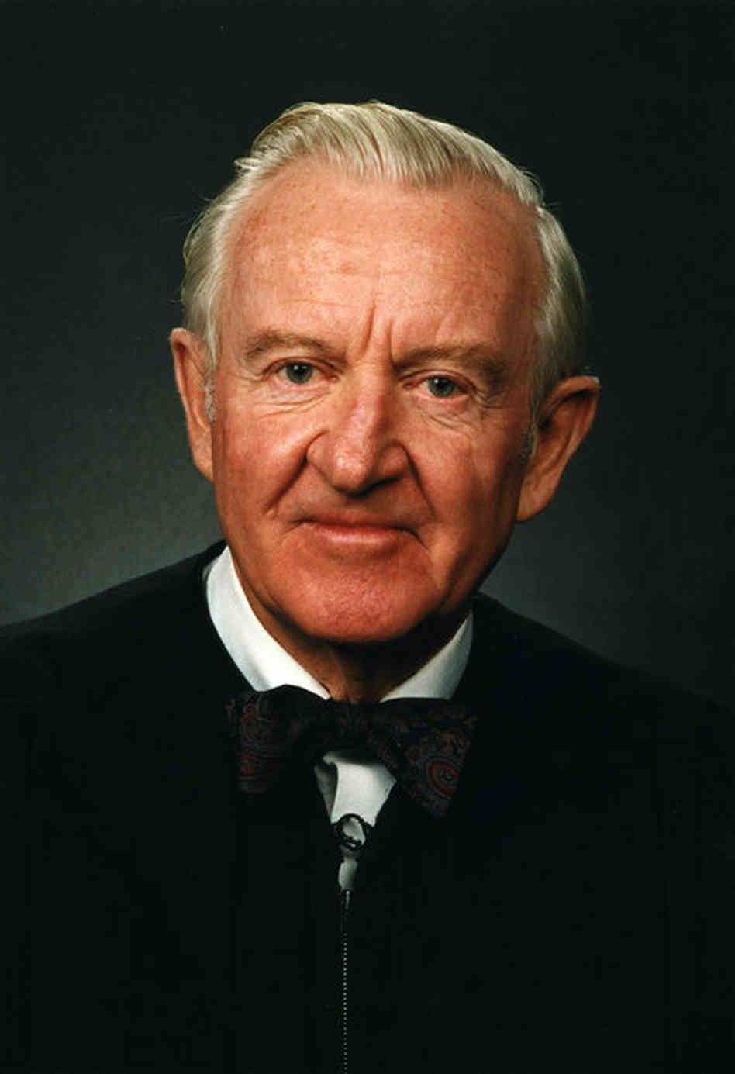
Justice Stevens

Slide 26
Dissent (Stevens): Overview
Decries majority’s lack of “judicial restraint”
  Overruling TWO prior decisions
  In any event, might have chosen narrower ground
    Non-profit v. for-profit corps
Some speaker-based restrictions appropriate
  Corps ≠ humans
  Broader understanding of “corruption”
More speech is NOT always better than less
Notes:
If taken seriously, our colleagues’ assumption that the identity of a speaker has no relevance to the Government’s ability to regulate political speech would lead to some remarkable conclusions. Such an assumption would have accorded the propaganda broadcasts to our troops by “Tokyo Rose” during World War II the same protection as speech by Allied commanders. More pertinently, it would appear to afford the same protection to multinational corporations **948 controlled by foreigners as to individual Americans: To do otherwise, after all, could “ ‘enhance the relative voice’ ” of some (i.e., humans) over others (i.e., nonhumans).
As a matter of original expectations, then, it seems absurd to think that the First Amendment prohibits legislatures from taking into account the corporate identity of a sponsor of electoral advocacy. As a matter of original meaning, it likewise seems baseless—unless one evaluates the First Amendment’s “principles,” ante, at 886, 912, or its “purpose,” ante, at 919 –920 (opinion of ROBERTS, C.J.), at such a high level of generality that the historical understandings of the Amendment cease to be a meaningful constraint on the judicial task. This case sheds a revelatory light on the assumption of some that an impartial judge’s application of an originalist methodology is likely to yield more determinate answers, or to play a more decisive role in the decisional process, than his or her views about sound policy.

Slide 27
The Aftermath

Slide 28
Holding Extended by
SpeechNow.org v. FEC (D.C. Circuit 2010)
  contributions by individuals
McCutcheon v. FEC (2014)
  aggregate contributions by entities in one election cycle

Slide 29
BUT
the current Court????

Slide 30
Questions?
Comments?

Slide 31
“Pay to Play” Restrictions
In the Lower Courts

Slide 32
Wagner v. FEC (D.C. Cir 2015)
52 U.S.C. § 30119(a)(1): makes it unlawful for any
  person “who enters into any contract with the U.S.
  ... directly or indirectly to make any contribution ... to any political party, committee, or candidate for public office or to any person for any political purpose.” (limited to feds)
  Prohibition applies
    “between the commencement of negotiations ... And
    ... the completion of performance” of the contract.
Upheld by unanimous D.C. Cir.!

Slide 33
D.C. Cir. in Wagner:
Even PROHIBITIONS on contributions = “closely drawn” std.
Gov’t interest tied tightly to prevention of qpq corruption
  And appearance thereof
Stressed long “unhappy” history of corruption in fed contracting

Slide 34
Opportunities
Recent unpleasantness
  = need for regulation
Cts tolerant of restrictions → past corruption
Acknowledge need for prophylactic rules
  Not all wrongdoing criminal
  Not all criminality caught and punished
  Need to restore public trust

Slide 35
Challenges
Identifying class implicated in
  Econ dev projects
Closing loopholes
  Entities/individuals
  Family members/3d parties
Timing
Moving goalposts???

Slide 36
BUT
the current Court????

Slide 37
Questions?
Comments?

Slide 38
Rebuilding Public Trust
Presentation to the Economic Development Reform Panel
April 23, 2021

Slide 39
Rebuilding Public Trust
Fundamentally, unethical behavior erodes public trust in institutions of government.
Public trust is hard to build, but easy to lose.
How to go about developing and implementing comprehensive ethics reform that:
  Reestablishes public trust in government;
  Enriches public servants’ understandings of ethical professional behavior; and
  Contributes to the establishment of fairer, more equitable systems in the long-term.

Slide 40
Rebuilding Public Trust
Categories of trust-building solutions:
  Communication
    e.g., CincyInsights dashboard.
  Consultation & Collaboration
    e.g., EDRP.
  Minimization of Wrongdoing
    e.g., ethics code of conduct + robust training and comprehensive information campaign.

Slide 41
Rebuilding public trust
In-house, manager-led training to emphasize support for the program.
  Presents strategic opportunity to aid general decision-making and transform organizational culture.
The more ethics education that public employees receive, the more likely they are to think themselves able to identify unethical behavior and have the courage to report it.
  Prompts:
    Will this make me or my supervisor uncomfortable?
    Will anyone get, or appear to get, an unfair advantage?
    Will this put the city at legal or economic risk?
    Will this make an unfavorable headline in the paper?

Slide 42
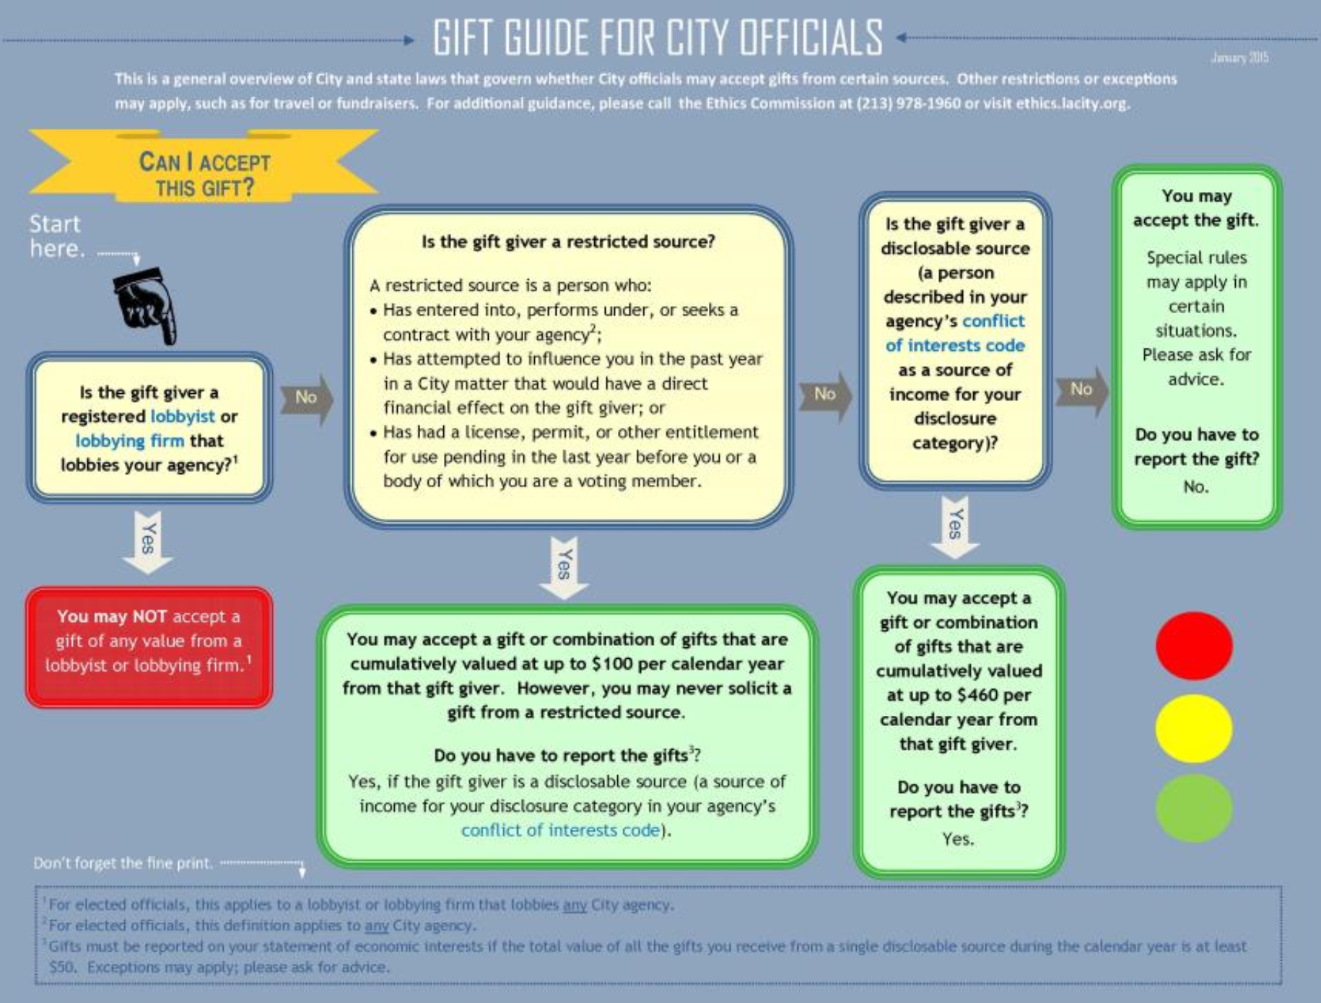
Rebuilding public trust
Materials distributed to all public employees and made accessible online should reinforce established ethical boundaries and encourage seeking an expert opinion when faced with a grey area.
Specialized materials should be targeted at elected officials, members of city commissions and boards, and employees in supervisory capacities.
Los Angeles City Ethics Commission gift flowchart

Slide 43
Rebuilding public trust
For ethical questions that cannot be easily answered by consulting the code of conduct, training programs and public information campaigns help considerably with filling in grey areas and minimizing wrongdoing.
Training should be adaptable and include mechanisms for trainee evaluation.
  Gauge effectiveness of the campaign and tailor future training to address identifiable deficiencies (e.g., “I know where to look for ethics guidance and am confident that meaningful action will be taken if I report unethical behavior”).

Slide 44
Chris Bryant
&
Evan Gildenblatt
chris.bryant@uc.edu

Slide 45
Questions?
Comments?

